Slide 1





Activity 6: Voting in person – Social story
Making voting easier for everyone

Slide 2

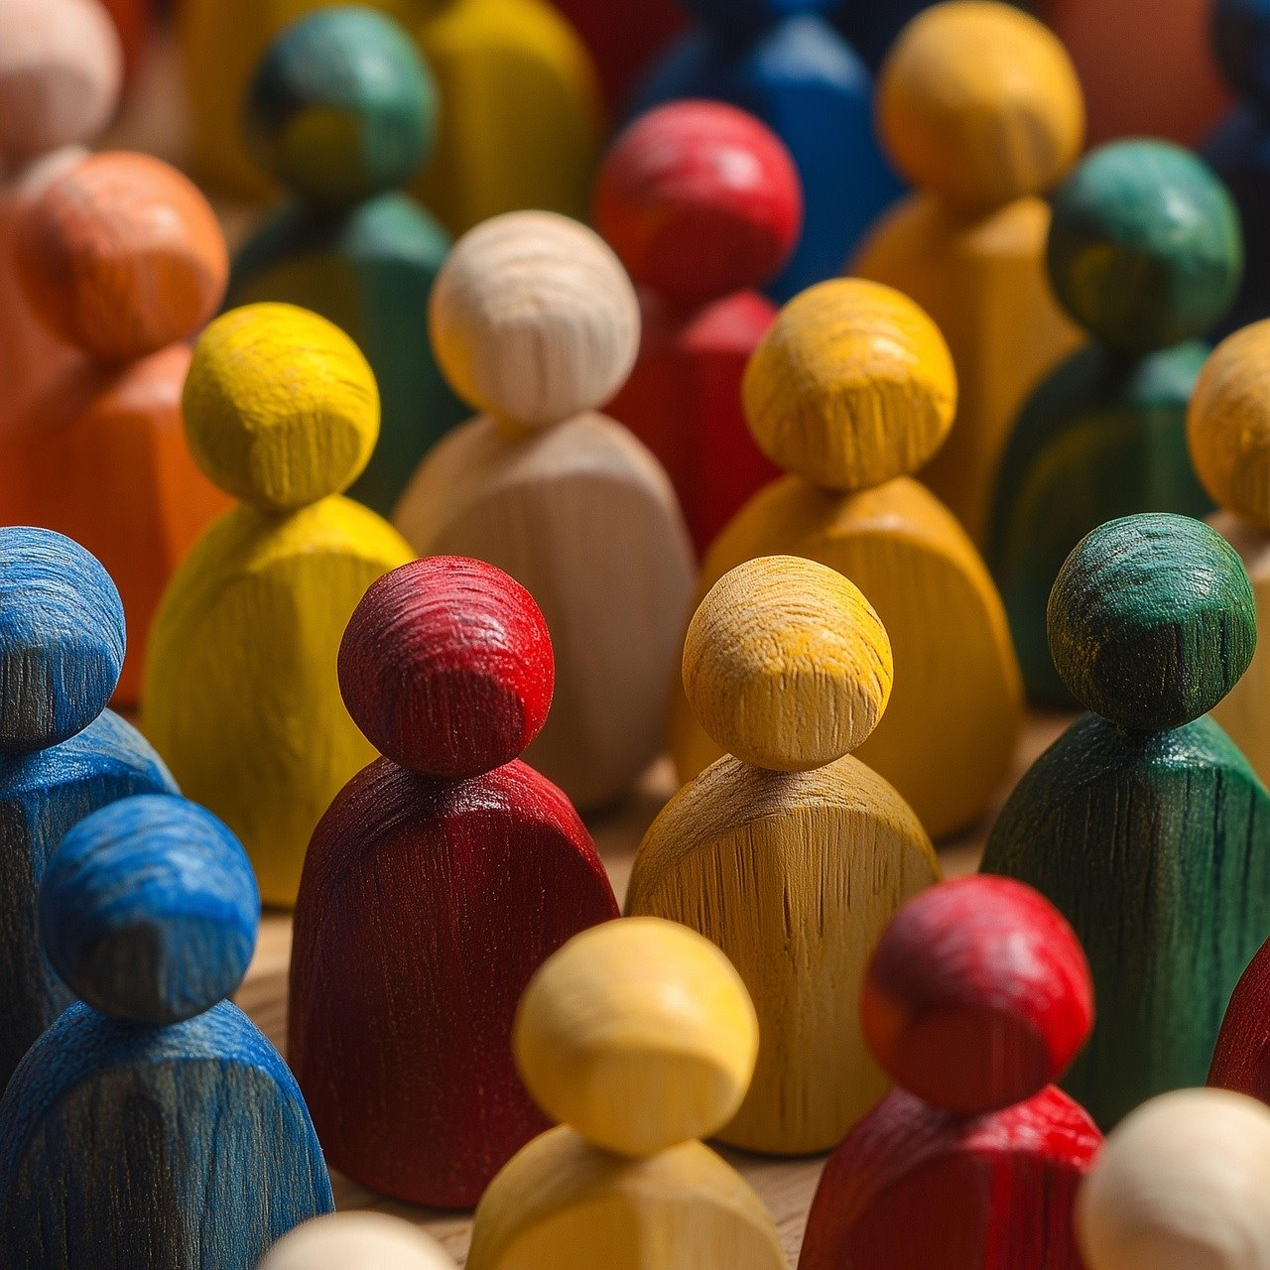

Ground rules
We take turns – everyone can share their opinion.
We treat all opinions as important.
We listen and use respectful words if we disagree.
Making voting easier for everyone
Notes:
Just to establish rules about allowing everyone to have an opinion and don’t judge them.

Slide 3
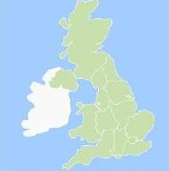

Democracy in England
Previously we learned about the following words:
This is all related to Politics – which means all the things that happen around voting, democracy and government.
UK
Democracy
Government
Prime minister
Cabinet
Parliament
Members of Parliament (MPs)
Party
Local Authorities
Local Councillors
General Election
Task:
Can you pick 3 words and either
draw an image that is related to the word
-or-
write a sentence describing the word.
The UK is…
A party is…
An MP is somebody who…
UK -
Party -
MPs -
Making voting easier for everyone
Notes:
Recap previous learning

Slide 4
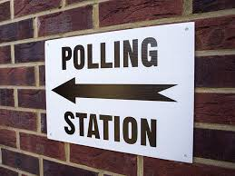

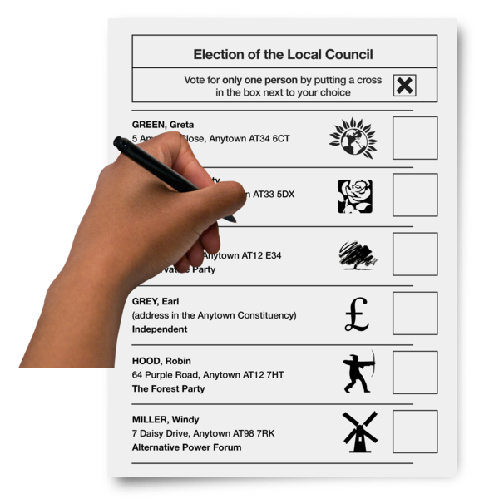

Social story – voting in person in England
Now:
We are going to watch a video explaining how you can vote in person during a general or local election.
Next:
We will look at each step in more detail – you can ask questions here too!
Making voting easier for everyone
Notes:
This covers things learned in previous lessons, take the opportunity to recap along the way. If you have symbols you already use for ‘now’ and ‘next’ tasks, please feel free to replace the current ones in the slide.

Slide 5
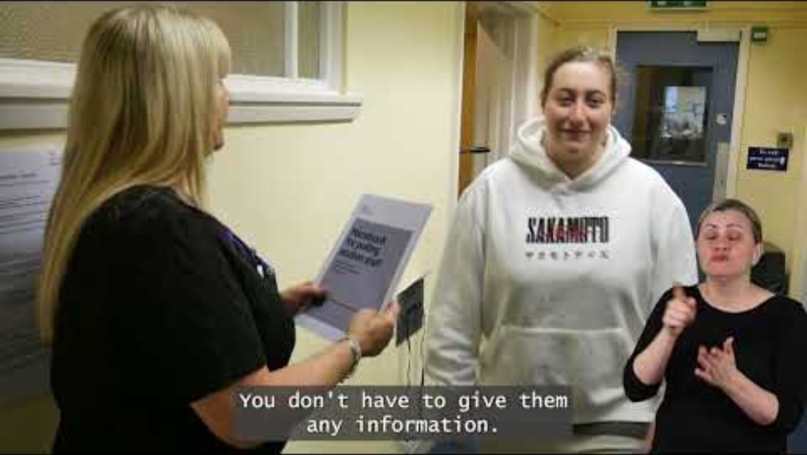
Notes:
This video covers every step in the Voting in person social story Easy Read document

Slide 6

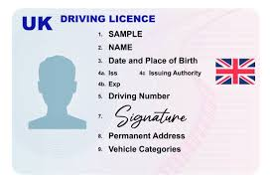
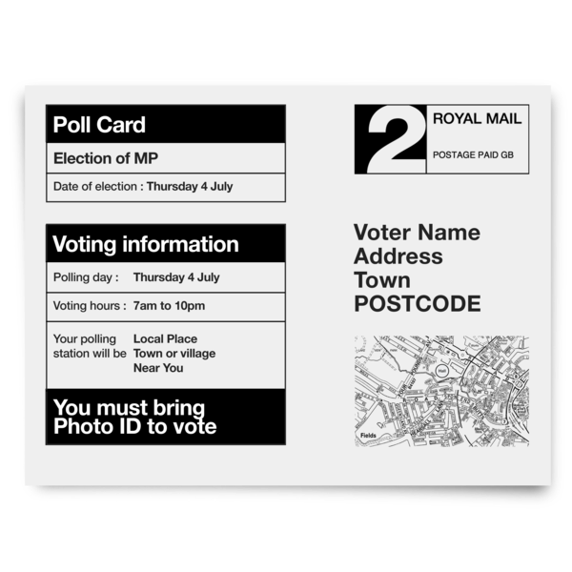
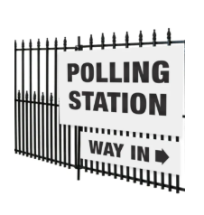
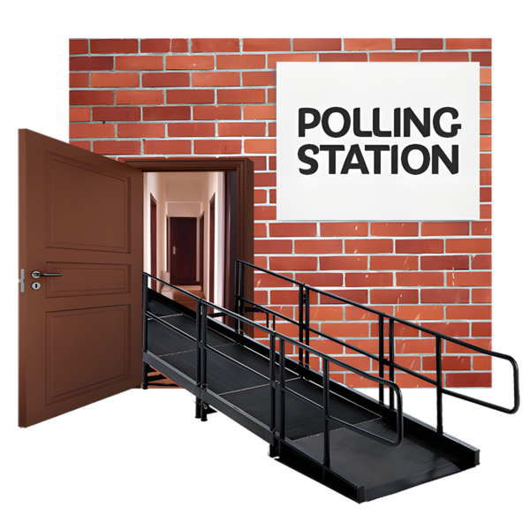
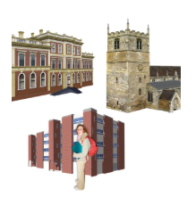
Social story – voting in person in England
When you have:
1. Registered to vote
2. Have your Photo ID or Voter Authority Certificate
3. An idea of who you are going to vote for…
You are ready to vote!
You will be sent a Poll Card by post, this will say what you can vote for, where and when you can vote.
You vote at a place called a Polling Station.
Polling Stations are usually in local buildings like halls, schools or churches. This will be close to where you live.
Before the polling day, you could visit your local Polling Station to find out what it is like.
Making voting easier for everyone
Notes:
This is the main written task. Text is from the easy read guide. Explore and recap as needed. Create your own mock polling station and role play the different steps in the video or PowerPoint.

Slide 7
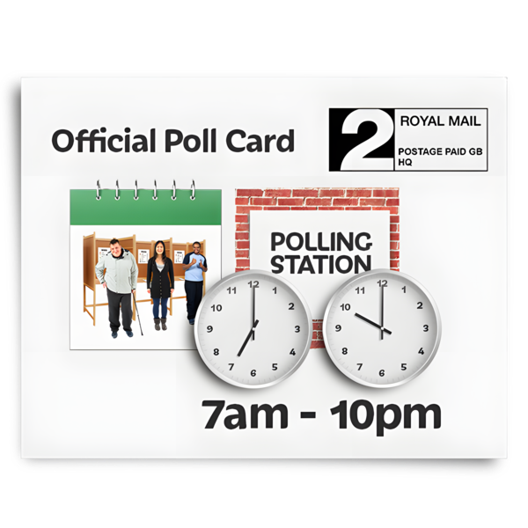
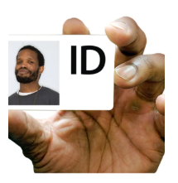
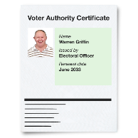
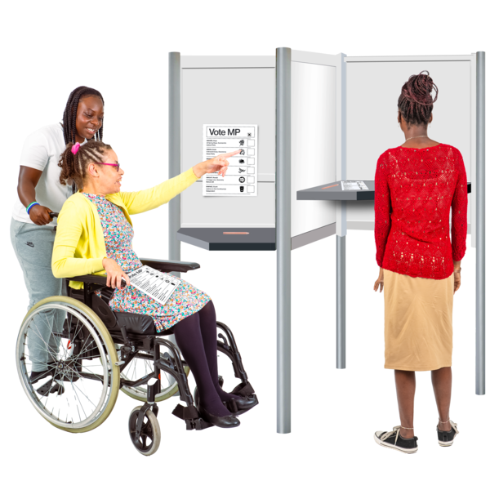
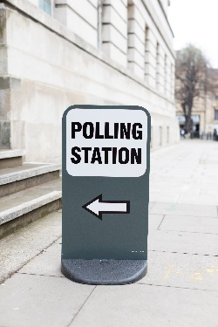
Social story – voting in person in England
On polling day, decide when you are going to vote and how you are going to get there.
Take your Photo ID or Voter Authority Certificate with you.
If you think you will need help, you can take someone with you to help you vote as long as they are over 18.
On polling day, go to the Polling Station and vote!
Making voting easier for everyone
Notes:
This is the main written task. Text is from the easy read guide. Explore and recap as needed. Create your own mock polling station and role play the different steps in the video or PowerPoint.

Slide 8
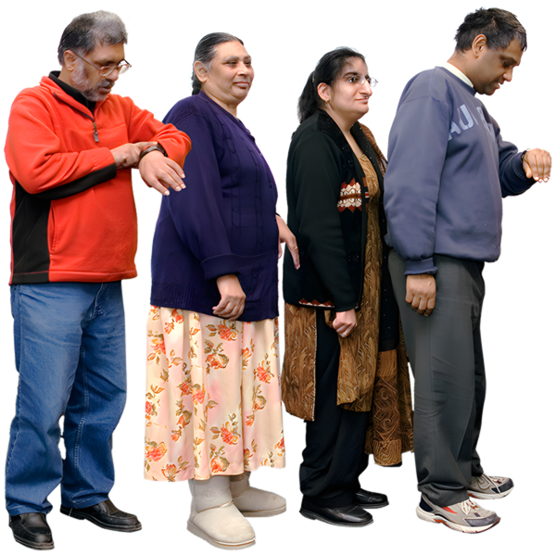


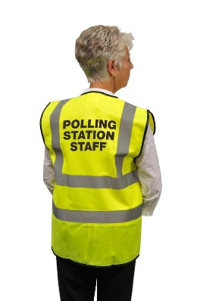

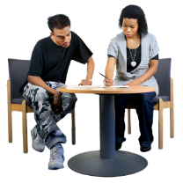
Social story – voting in person in England
When you get to the polling station, there might be lots of other people waiting to vote. If this is difficult for you then you can ask the polling station staff for help
There might be someone outside asking for your name and address, this is so they know who is voting. You don’t have to give them any information.
When it is your turn someone will let you know.
When it is your turn one of the polling station staff will ask to see your Photo ID or Voter Authority Certificate. They will then ask for your address.
If you need help or support then you can ask for help from the polling station staff
Making voting easier for everyone
Notes:
This is the main written task. Text is from the easy read guide. Explore and recap as needed. Create your own mock polling station and role play the different steps in the video or PowerPoint.

Slide 9
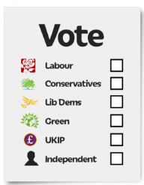
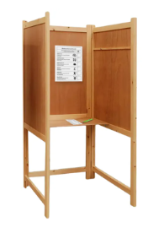
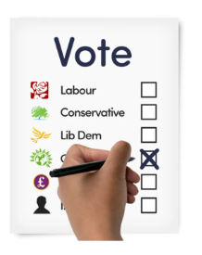
Social story – voting in person in England
The polling station staff will give you a ballot paper.
Take your ballot paper into one of the polling booths.
This is a private area where you can vote without anyone else seeing.
There are instructions on the ballot paper. If you need help to understand these ask the polling station staff.
Put a cross in the box next to who you want to vote for.
You might be asked to vote for more than one person.
Making voting easier for everyone
Notes:
This is the main written task. Text is from the easy read guide. Explore and recap as needed. Create your own mock polling station and role play the different steps in the video or PowerPoint.

Slide 10
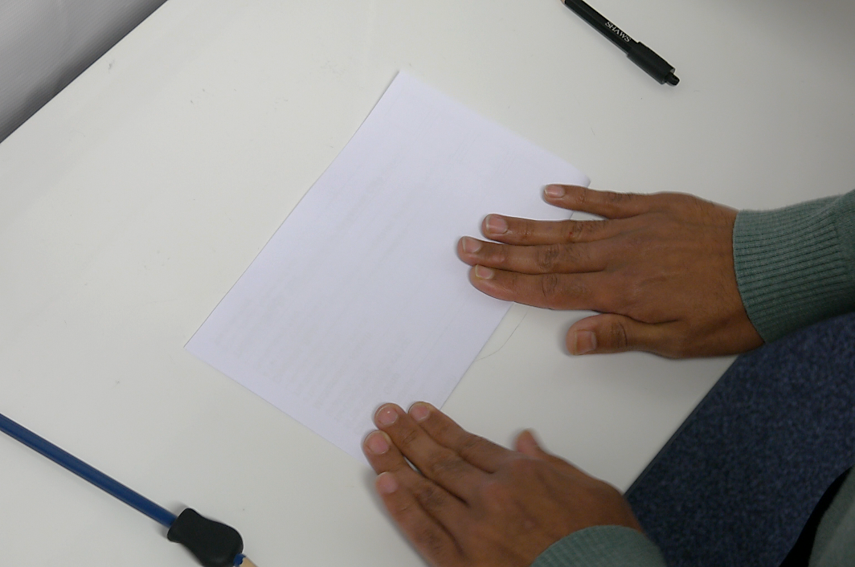
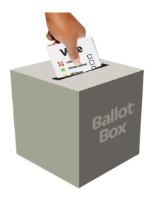
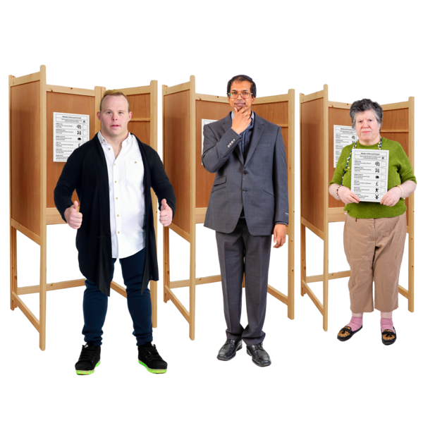
Social story – voting in person in England
When you put a cross where you want to, fold the paper in half.
Leave the polling booth and put your paper in the ballot box.
Well done! You have voted. You should quietly leave the polling station now.
Making voting easier for everyone
Notes:
This is the main written task. Text is from the easy read guide. Explore and recap as needed. Create your own mock polling station and role play the different steps in the video or PowerPoint.

