Slide 1





Activity 5: Photo ID
Making voting easier for everyone

Slide 2



Ground rules
We take turns – everyone can share their opinion.
We treat all opinions as important.
We listen and use respectful words if we disagree.
Making voting easier for everyone
Notes:
Just to establish rules about allowing everyone to have an opinion and don’t judge them.

Slide 3

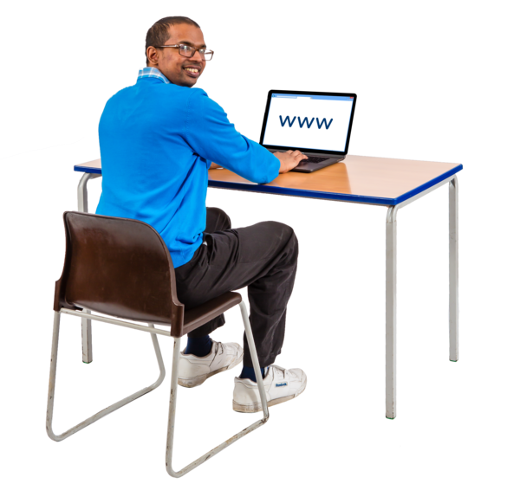

Recap
Proxy
Post
In-person
What are the three different ways we can vote?
What must we do before we can vote?
Register to vote!
Anyone working at a polling station or we can bring a trusted adult over 18
If we need help, who can we ask?
Making voting easier for everyone
Notes:
Recap previous learning using a quick quiz. Boxes can be pulled away to reveal answers.

Slide 4

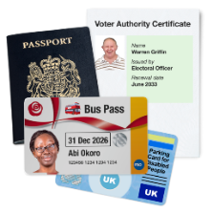
Photo ID
Can anyone tell me what ID is?
Can you give an example?
When you vote in person, you must show a form of ID.
This can include:
Passport
Driving Licence
Disabled Person’s Bus Pass
PASS Card
Voter Authority Certificate
Making voting easier for everyone
Notes:
Intro to topic – ask who has these sorts of ID. Note – Photo/Voter ID only needed if voting in person.
You can get a PASS Card online
- www.postoffice.co.uk/identity/pass-card

Slide 5
Photo ID – apply online
You only need ID when voting in person!
Making voting easier for everyone
Notes:
Ask learners if they have seen these types of ID before or if they already have one. Explore the application process for each, especially the free voter certificate either on the board or on tablets if they have them.
Other forms of ID can be found here: https://www.electoralcommission.org.uk/voting-and-elections/voter-id/accepted-forms-photo-id

Slide 6

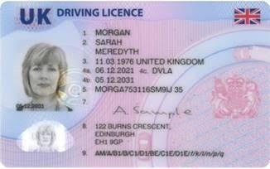
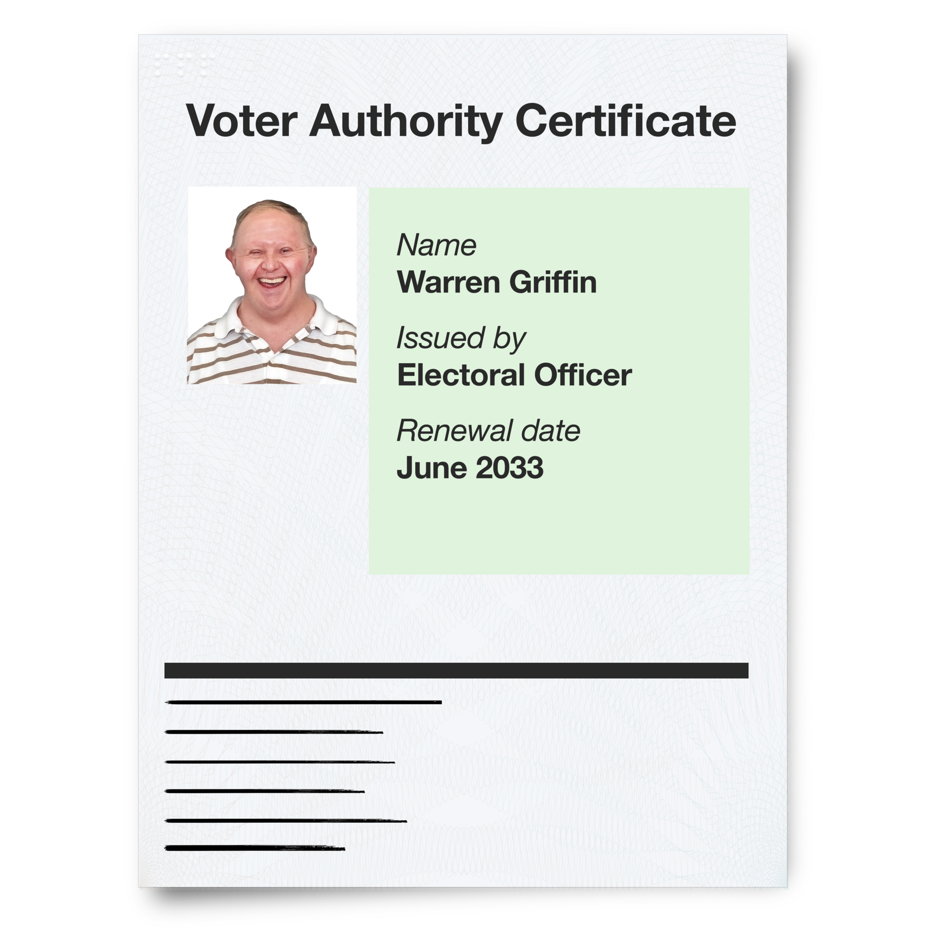
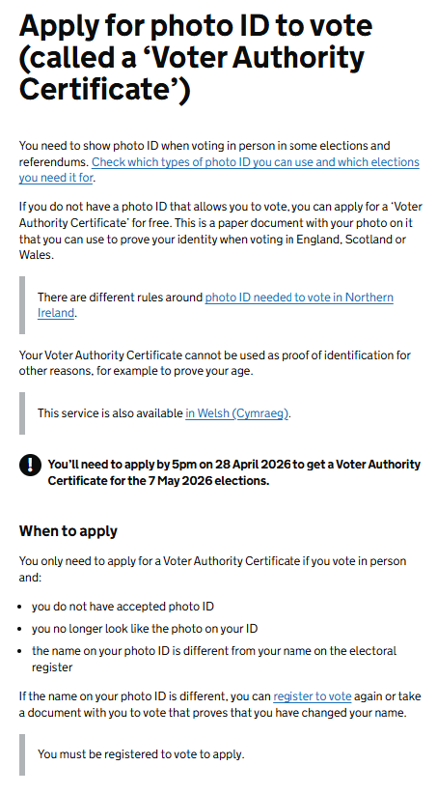
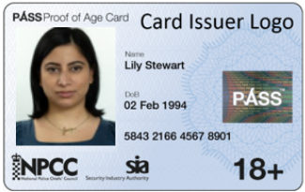
Photo ID – apply online
Let's explore how to apply for a free Voter Authority Certificate.
You only need this if you don't have any other forms of accepted ID.
£102
Also allows you to travel abroad.
£34
Widely accepted form of ID.
£15
Widely accepted proof of age.
Making voting easier for everyone
Notes:
Ask learners if they have seen these types of ID before or if they already have one. Explore the application process for each, especially the free voter certificate either on the board or on tablets if they have them.
Other forms of ID can be found here: https://www.electoralcommission.org.uk/voting-and-elections/voter-id/accepted-forms-photo-id

Slide 7
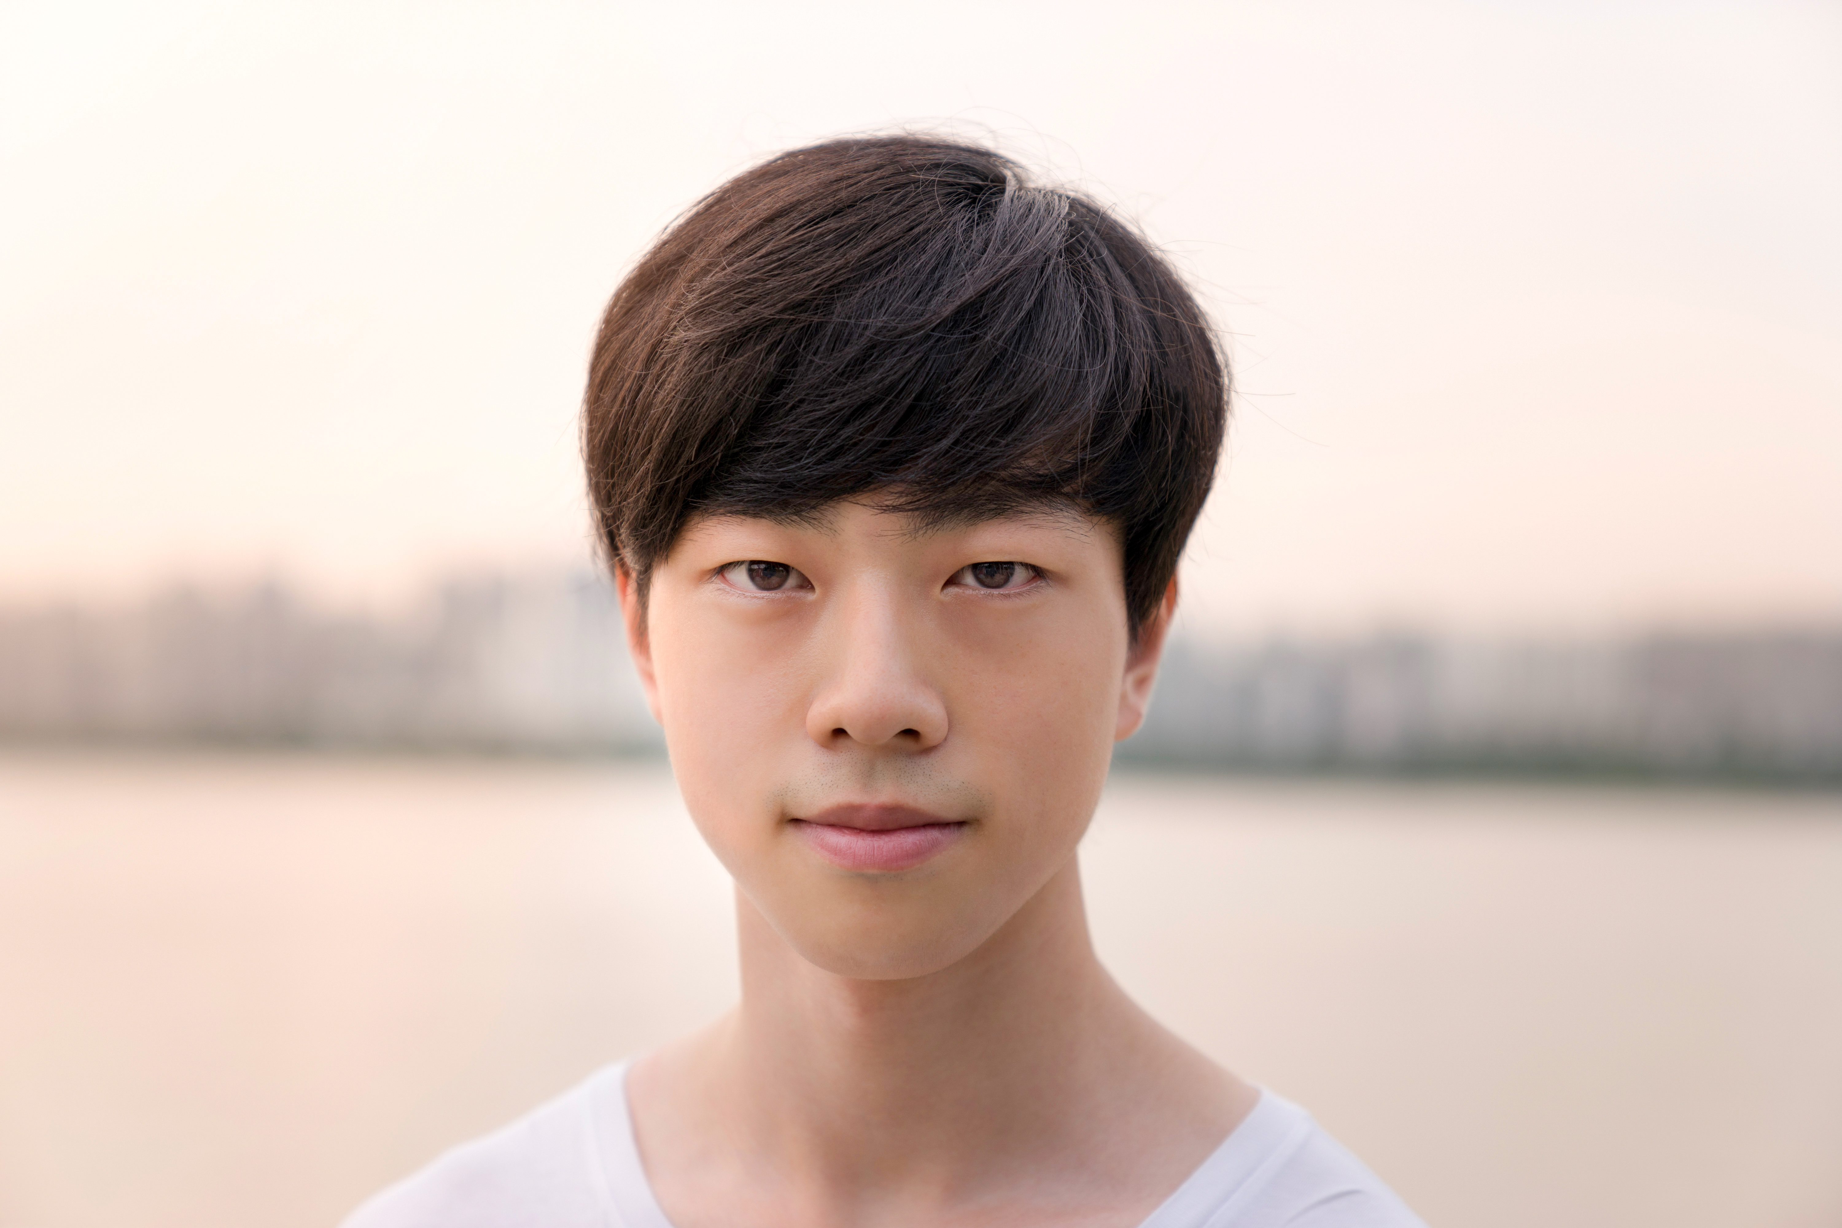



Create your own ID checklist poster!
What should Photo ID include?
_
_
_
_
Photo ID
Making voting easier for everyone
Notes:
Name
Photo
DOB
Address
Note – not all forms of ID will have an address such as a passport. This is a good opportunity however for learners to practice writing their address for when they register to vote or for other uses.

Slide 8

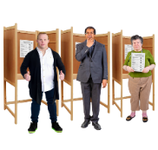
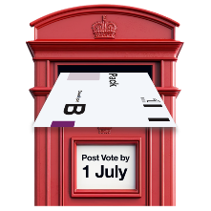
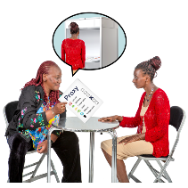
Photo ID – Easy read
Once you are registered to vote, you will need to have a Photo ID to show if you vote in person. This Photo ID proves who you are.
There are different ways to vote in the UK:
In person (on your own or with support)
Postal voting
Proxy voting (when someone votes for you)
You only need Photo if you are voting in person.
Making voting easier for everyone
Notes:
Name
Photo
DOB
Address
Remind learners they must have a form of ID they have applied for – the ID they are creating is for fun and to practice skills like writing an address and cannot be used at polling stations. These can also be used next lesson for election day role play.

Slide 9
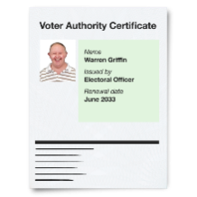

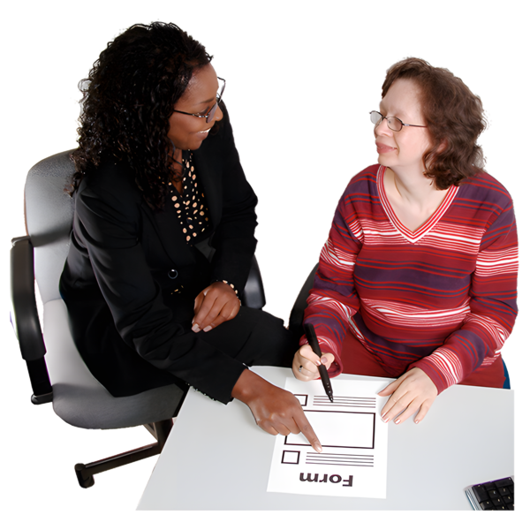
Photo ID – Easy read
You can use lots of different types of ID for your Photo ID:
Driving Licence
Passport
Blue Badge Card
PASS Cards (Proof of Age Standards Scheme)
If you don’t have a Photo ID then you can get a FREE Voter Authority Certificate.
You can get a Voter Authority Certificate online
You might want to get help from someone to help you register to vote as the form can be a little bit complicated.
Making voting easier for everyone
Notes:
Name
Photo
DOB
Address
Remind learners they must have a form of ID they have applied for – the ID they are creating is for fun and to practice skills like writing an address and cannot be used at polling stations. These can also be used next lesson for election day role play.

