Slide 1





Activity 4: Different ways to vote
Making voting easier for everyone

Slide 2



Ground rules
We take turns – everyone can share their opinion.
We treat all opinions as important.
We listen and use respectful words if we disagree.
Making voting easier for everyone
Notes:
Just to establish rules about allowing everyone to have an opinion and don’t judge them.

Slide 3

Different ways to vote
Can you guess the three different ways you can vote using the pictures?
By Proxy
By Post
In person
Making voting easier for everyone
Notes:
Introduction to the main topic. Discuss why you might want to choose one way of voting over another. The boxes can be removed to reveal the answers - (by proxy, in person, by post)

Slide 4
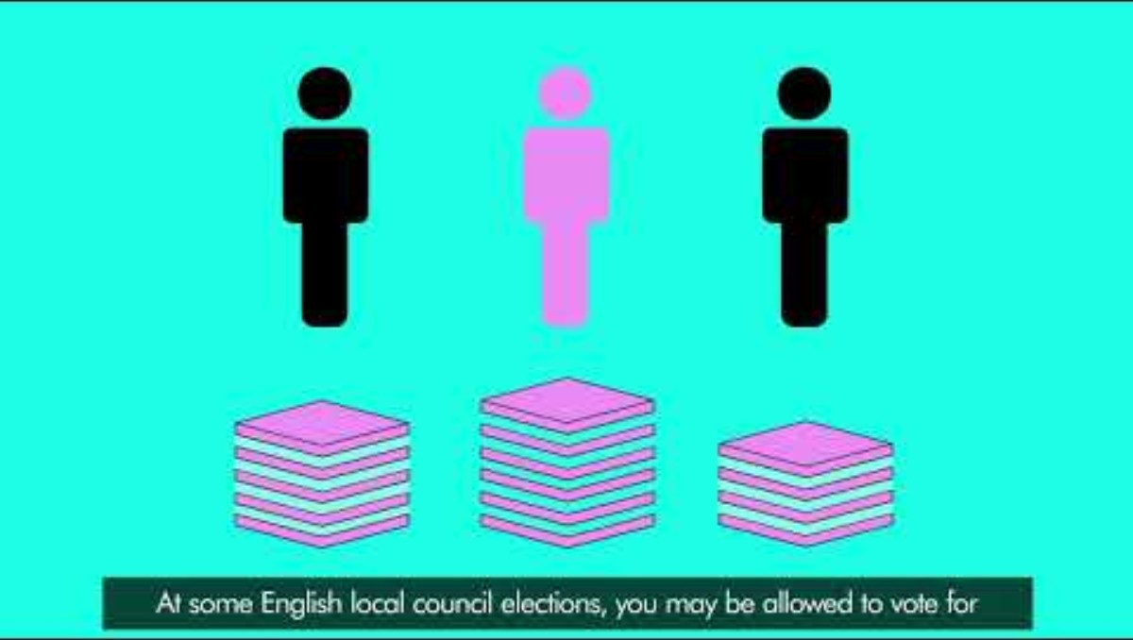

Slide 5
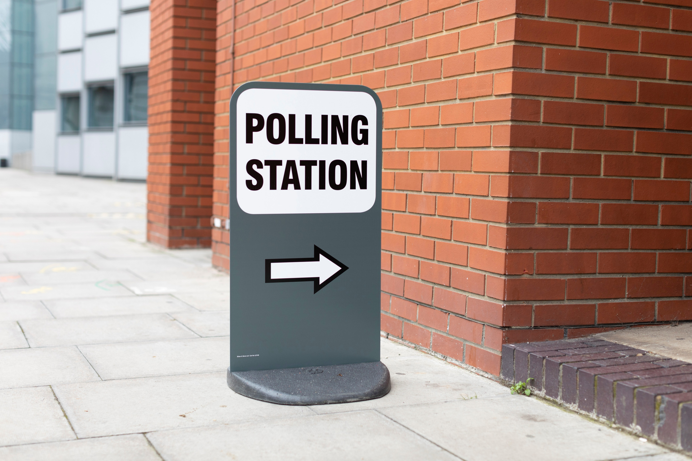


Different ways to vote – Voting in person
To vote in person, you need to visit a polling station.
Polling stations are usually in community buildings like town halls, schools and churches close to where you live.
Anyone working at a polling station can help you, but you can also bring a trusted adult if you'd prefer – they must be over 18.
Making voting easier for everyone
Notes:
This is just and introduction, voting in person is covered in a lot more detail in topic 6. Potentially you could research. Photo and Voter Authority Certificate are covered in topic 5

Slide 6
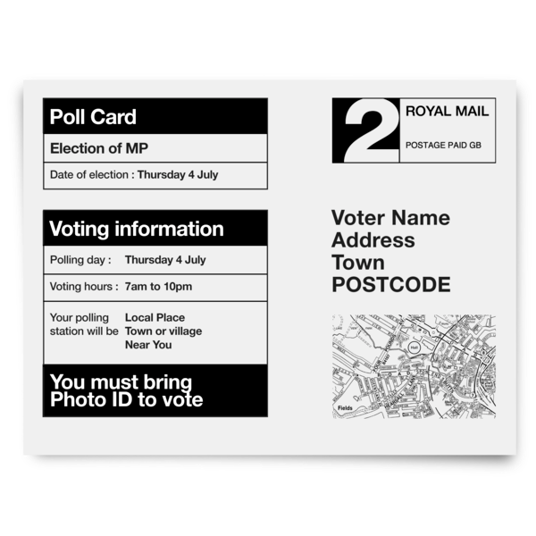

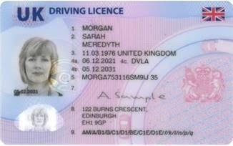
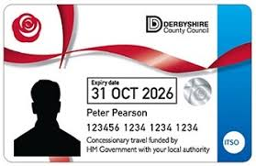
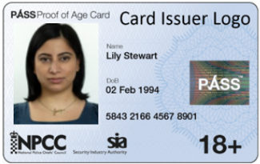
Different ways to vote – Voting in person
A few weeks before an election, you will be sent a poll card.
This will tell you where to vote.
You can also check where your polling station is using this website:
www.electoralcommission.org.uk/voting-and-elections/ways-vote/voting-person
You must remember to bring Photo ID!
Making voting easier for everyone
Notes:
This is just an introduction, voting in person is covered in a lot more detail in topic 6. Potentially you could research. Photo and Voter Authority Certificate are covered in topic 5

Slide 7


Different ways to vote – Postal voting
You can apply online for a postal vote application pack here:
www.gov.uk/how-to-vote/postal-voting
Think, Pair, Share:
Why might someone prefer to vote by post?
Who can help us apply for a postal vote?
Making voting easier for everyone
Notes:
Accept any reasonable answer here.

Slide 8
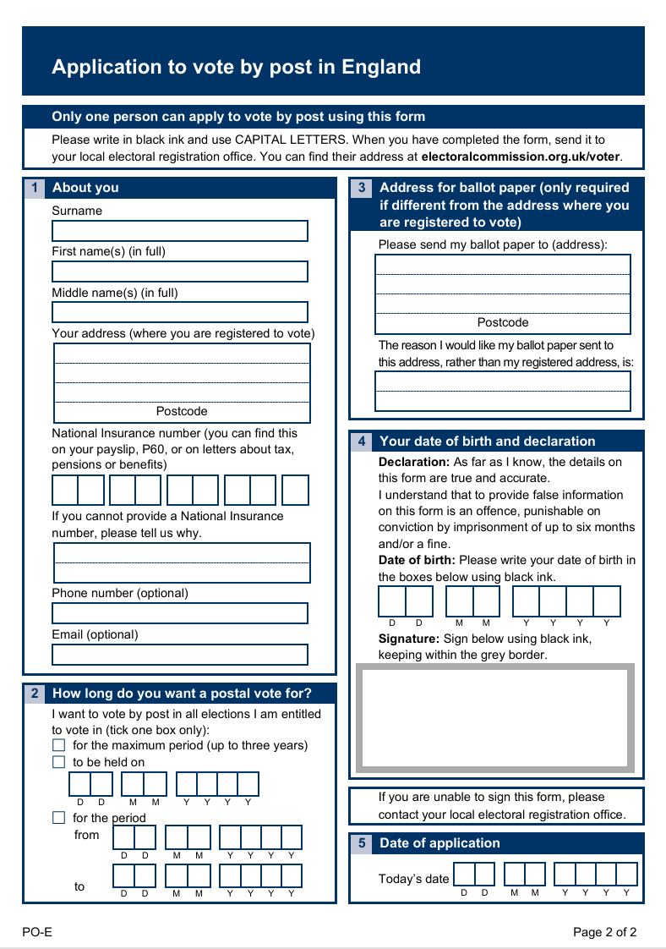
Different ways to vote – Postal voting
You can apply online for a postal vote application pack here:
www.gov.uk/how-to-vote/postal-voting
Making voting easier for everyone
Notes:
Feel free to go through this with learners – you could also print this out to practice filling out or for learners to fill out to apply for a postal vote.

Slide 9
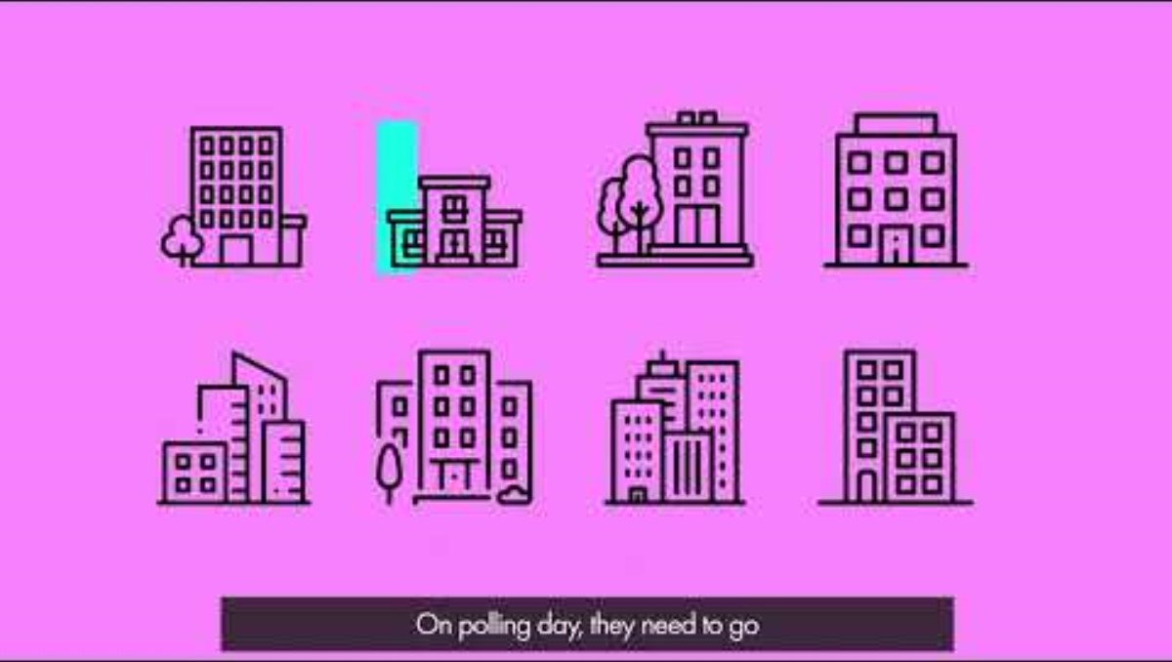

Slide 10

Different ways to vote – Proxy voting
As a class, can you write a definition of voting by proxy?
Proxy voting means someone votes on your behalf
You can find more information about proxy voting here:
www.gov.uk/apply-proxy-vote
Making voting easier for everyone
Notes:
Accept any reasonable answer - 'If you’re unable to vote in person you can ask someone to vote on your behalf. This is called a proxy vote.'

Slide 11
Different ways to vote – Proxy voting
You are only allowed to vote by proxy for one of four reasons.
_ _ _ _ _ _ _ _ / _ _ _ _ _
_ _ _ _
_ _ _ _ _ _ _ _ _ _
_ _ _ _ / _ _ / _ _ _ _ _ _ _ _/ _ _ _ _ _ _ _
Making voting easier for everyone
Notes:
Hangman:
Overseas Voter
Away
Disability
Work / Military Service
Using a whiteboard will likely be easier than doing this on the PowerPoint depending on the resources in your room.

Slide 12
Different ways to vote – Quiz!
What are the three different ways you can vote?
What is the name of the place where you vote in person?
What do you need to take with you?
Will you have to travel a long way to vote?
Can you get help to vote?
Do you have to let someone know why you want to use a postal vote?
How do you apply for a postal vote?
What is it called when someone votes for you?
How do you find out more about this?
Making voting easier for everyone
Notes:
This is a simple recap quiz.

Slide 13
Different ways to vote – Quiz!
What are the three ways you can vote?
In person, by post, by proxy
What is the name of the place where you vote in person?
Polling Station
What do you need to take with you?
Photo ID (or voter authority certificate)
Will you have to travel far?
No, the Polling station should be close to where you live
Can you get help to vote?
Yes, someone can come with you to vote or you can ask polling station staff for help
Do you need to explain why you want a postal vote?
No
How do you apply for a postal vote?
Complete and online form
What is it called when someone votes for you?
Voting by proxy
Where can you find out more?
The Electoral Commission website
Making voting easier for everyone
Notes:
This is a simple recap quiz.

Slide 14
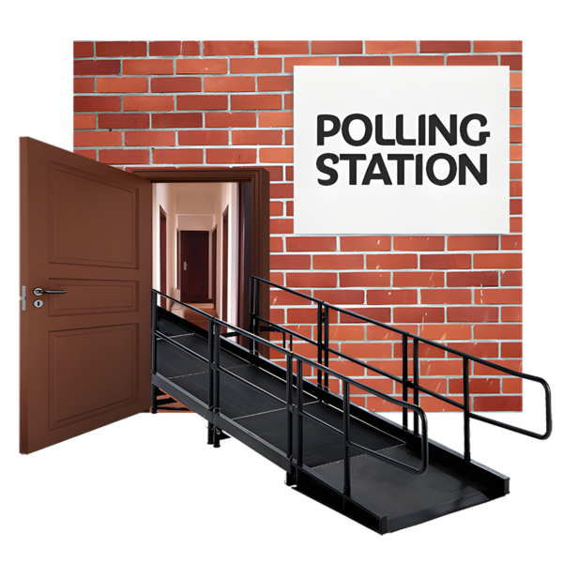
Different ways to vote – Easy read
Whenever you vote, there are three different ways you can vote:
In person at a polling station
You can vote by post, this is called a postal vote.
You can apply to do this online.
You can vote by proxy, this is where you tell someone who you want to vote for and they vote for you. You can find out how to do this online.
http://www.gov.uk/apply-proxy-vote
Making voting easier for everyone
Notes:
This is the main written task. Text is from the easy read guide.

