Slide 1
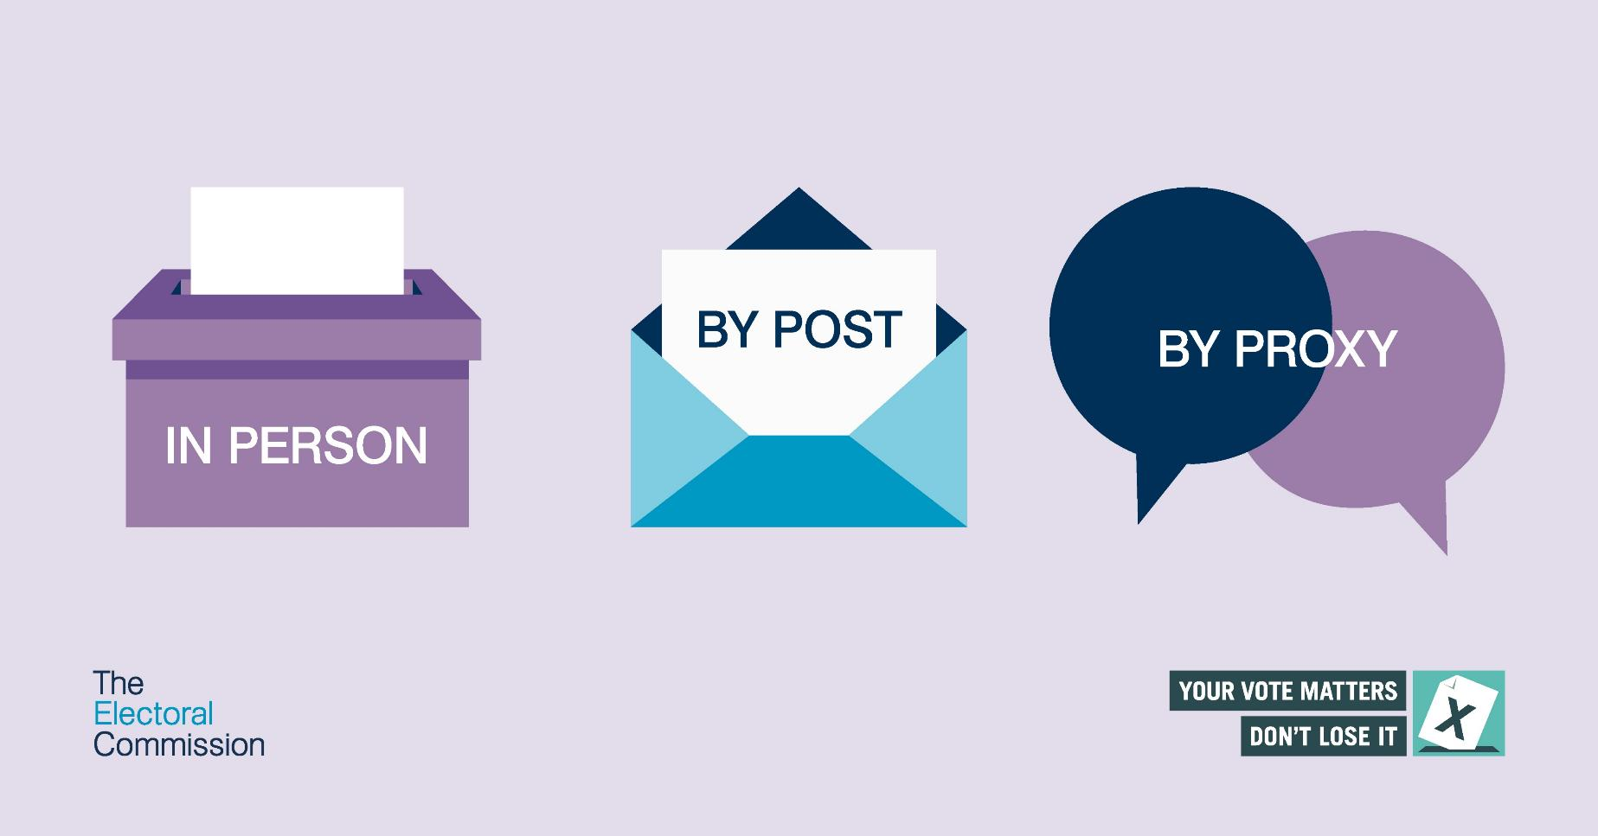




Activity 3: Registering to vote
Making voting easier for everyone

Slide 2



Ground rules
We take turns – everyone can share their opinion.
We treat all opinions as important.
We listen and use respectful words if we disagree.
Making voting easier for everyone
Notes:
Just to establish rules about allowing everyone to have an opinion and don’t judge them.

Slide 3


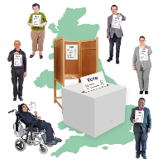
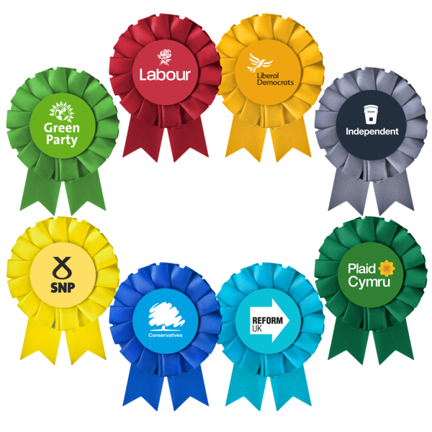
Bingo!
Draw a box with 6 squares.
Choose 6 words below.
Put one word in each box.
UK
Democracy
Government
Prime minister
Cabinet
Parliament
Members of Parliament (MPs)
Party
Local Authorities
Local Councillors
General Election
Making voting easier for everyone
Notes:
Recap previous learning

Slide 4
Bingo!
When your teacher reads out a word in your box, raise your hand and tell the class what the word means.
2. Cross out the word that is called out if someone says the meaning of the word.
3. First person with all their words crossed out wins!
Making voting easier for everyone
Notes:
Recap previous learning

Slide 5
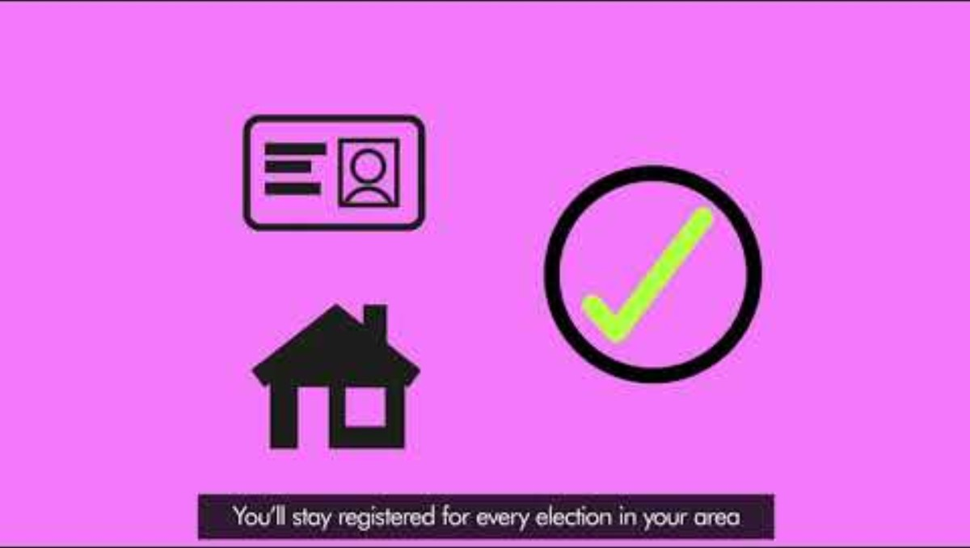
Notes:
This is a recap about voting – ending about an important step – Registering to vote.

Slide 6
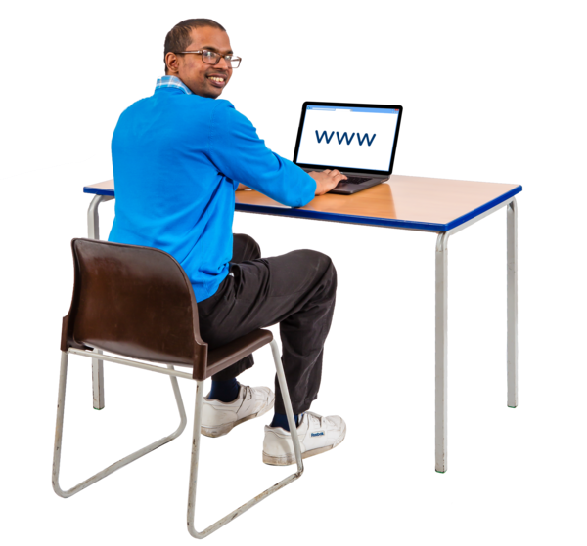
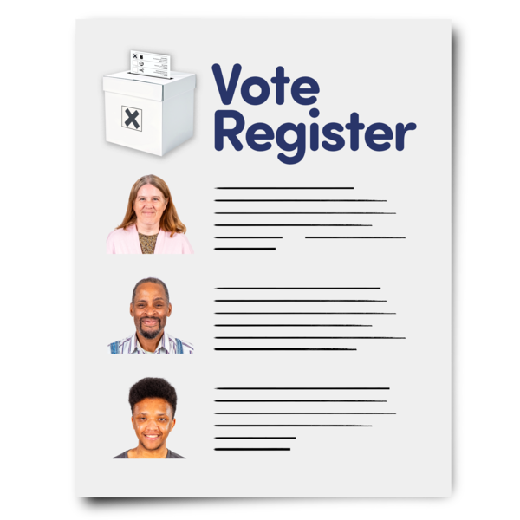
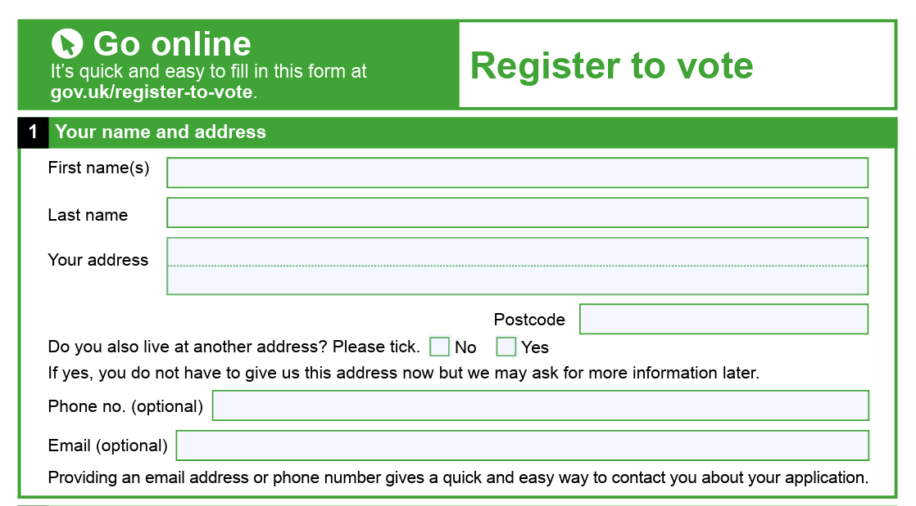
Registering to vote
Before you can vote in an UK election, you need to Register to vote.
This can be done online, or by filling in a paper form.
We will have an opportunity to look at the website used to register to vote.
Making voting easier for everyone
Notes:
This is an opportunity to visit the website and find local elections office. Next slides will take you through the steps.

Slide 7
How do we register to vote? - Online
Make sure you know your:
1. National Insurance Number
2. Postcode
3. Date of Birth
On any device, go to www.gov.uk/register-to-vote
Follow the instructions and you will be registered to vote in the next local and general elections!
Making voting easier for everyone
Notes:
This is an opportunity to visit the site and look at how to register. If appropriate, then you could support young people to register to vote.

Slide 8
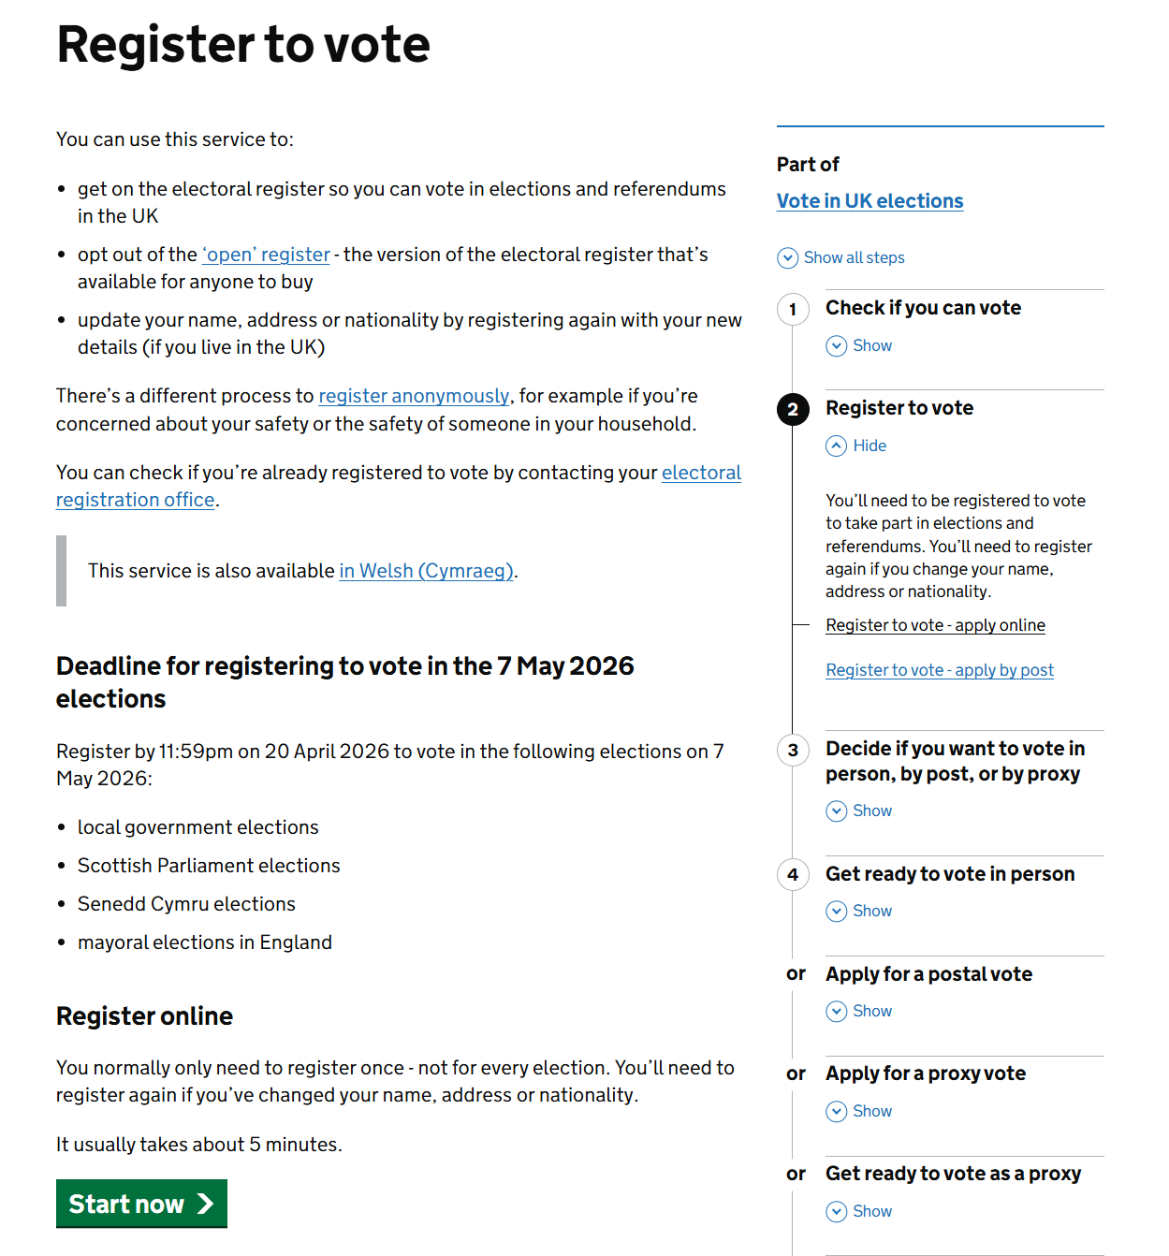
How do we register to vote? - Online
Here, you can also find more information about applying to vote by post, as well as different ways to vote.
Making voting easier for everyone
Notes:
This is an opportunity to visit the site and look at how to register. If appropriate, then you could support young people to register to vote.
You could show them the website live here - Register to vote - GOV.UK. Note they can also use a search engine to look up 'register to vote' and this should be the top result.

Slide 9
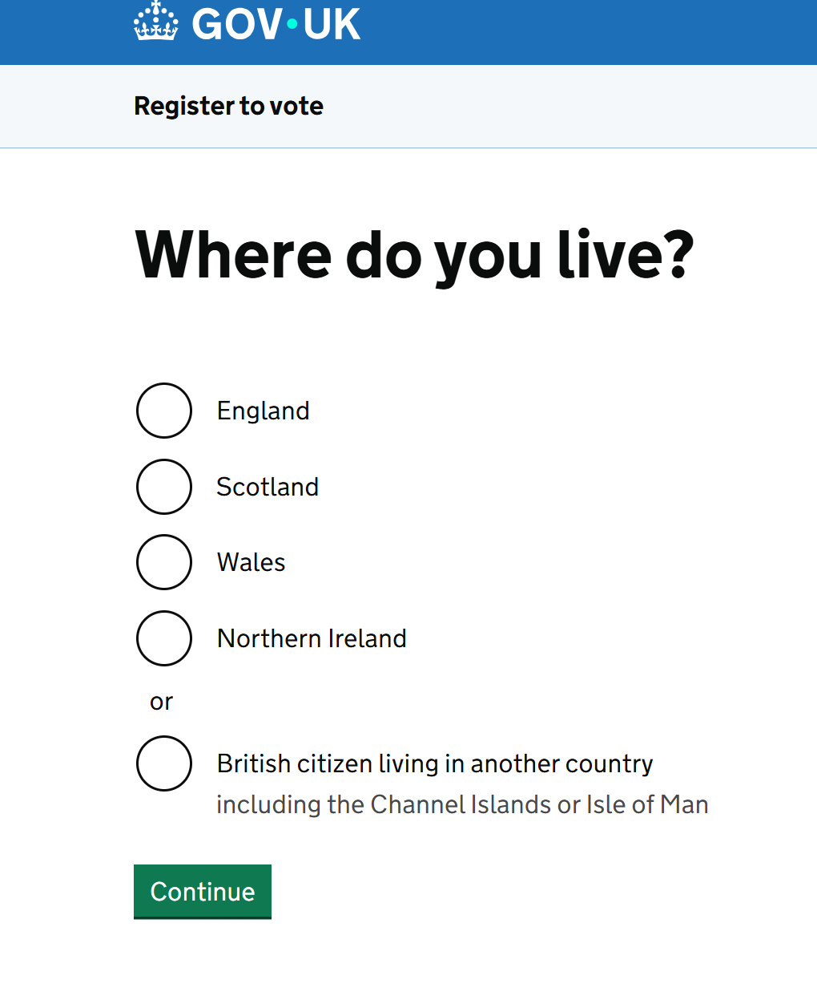
How do we register to vote? - Online
Making voting easier for everyone
Notes:
This is an opportunity to visit the site and look at how to register. If appropriate, then you could support young people to register to vote.
You could show them the website live here - Register to vote - GOV.UK. Note they can also use a search engine to look up 'register to vote' and this should be the top result.

Slide 10
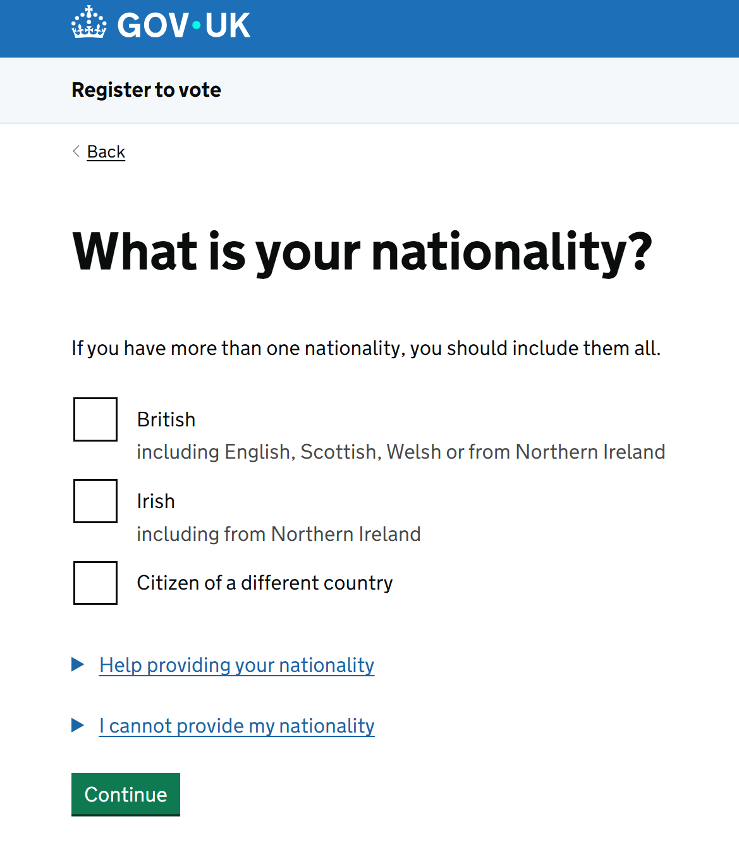
How do we register to vote? - Online
If you aren't sure, you can click these blue links – they will give you helpful information.
Making voting easier for everyone
Notes:
This is an opportunity to visit the site and look at how to register. If appropriate, then you could support young people to register to vote.
You could show them the website live here - Register to vote - GOV.UK. Note they can also use a search engine to look up 'register to vote' and this should be the top result.

Slide 11
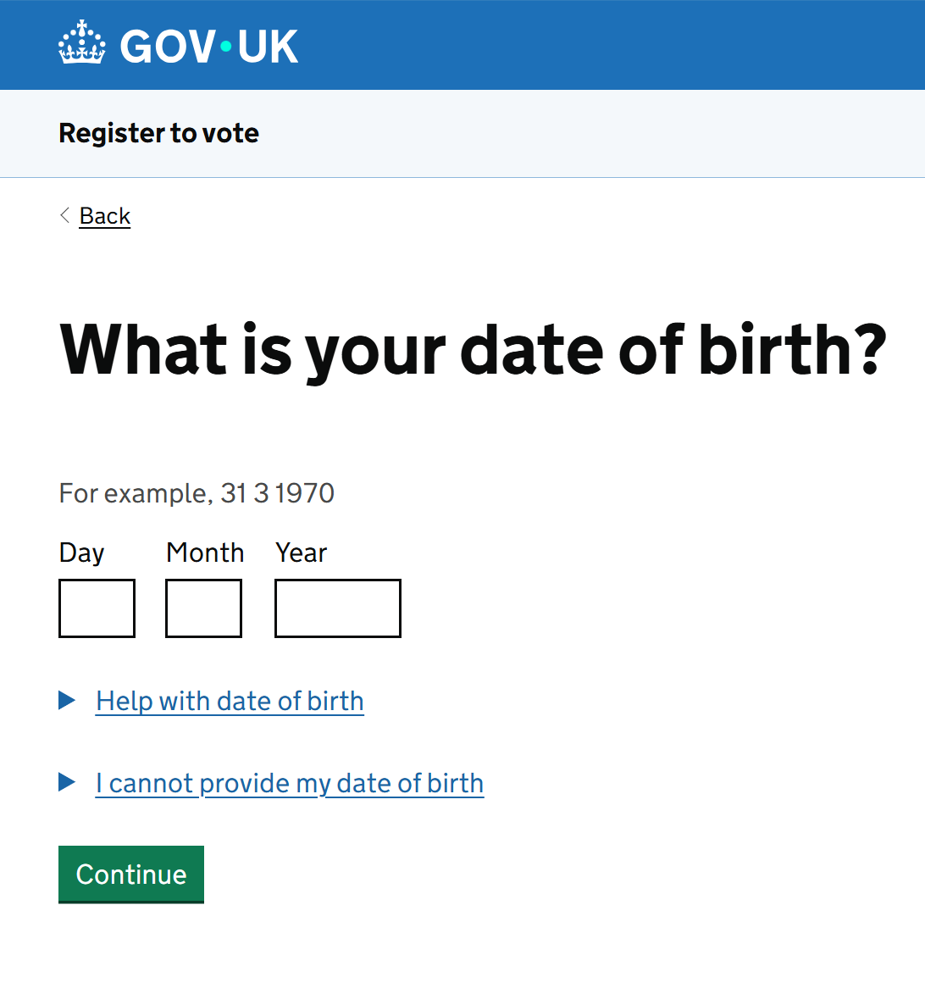
How do we register to vote? - Online
Making voting easier for everyone
Notes:
This is an opportunity to visit the site and look at how to register. If appropriate, then you could support young people to register to vote.
You could show them the website live here - Register to vote - GOV.UK. Note they can also use a search engine to look up 'register to vote' and this should be the top result.

Slide 12
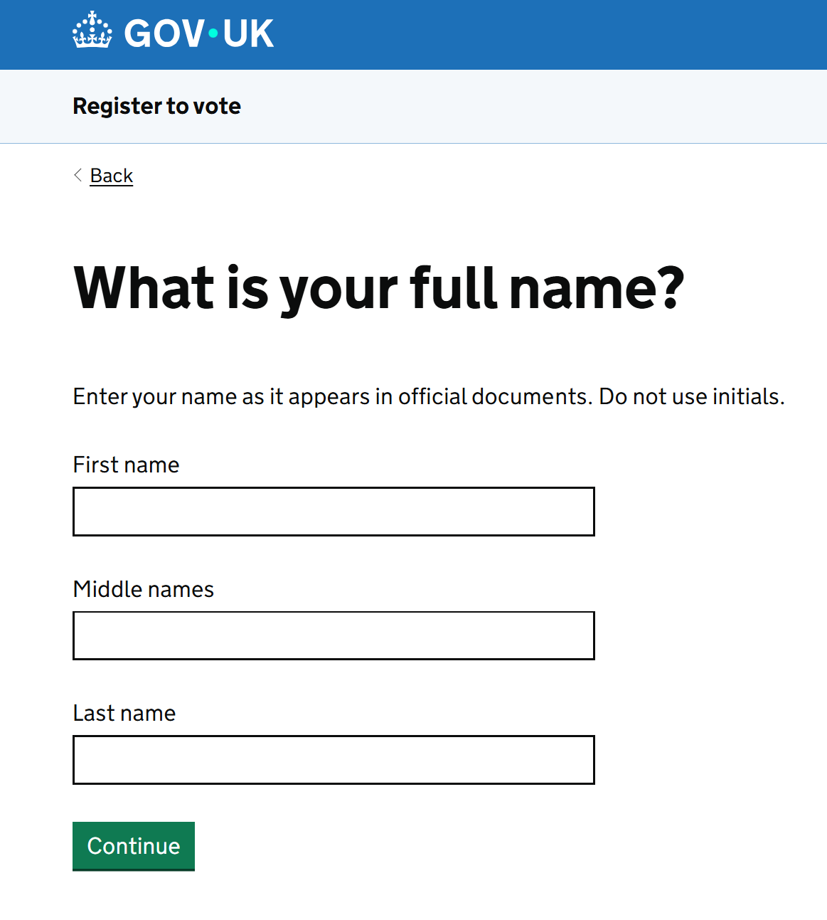
How do we register to vote? - Online
You must use your full name – no nicknames or initials. For example, if your full name is Daniyal but everyone calls you Dan, you must still write Daniyal.
Making voting easier for everyone
Notes:
This is an opportunity to visit the site and look at how to register. If appropriate, then you could support young people to register to vote.
You could show them the website live here - Register to vote - GOV.UK. Note they can also use a search engine to look up 'register to vote' and this should be the top result.

Slide 13
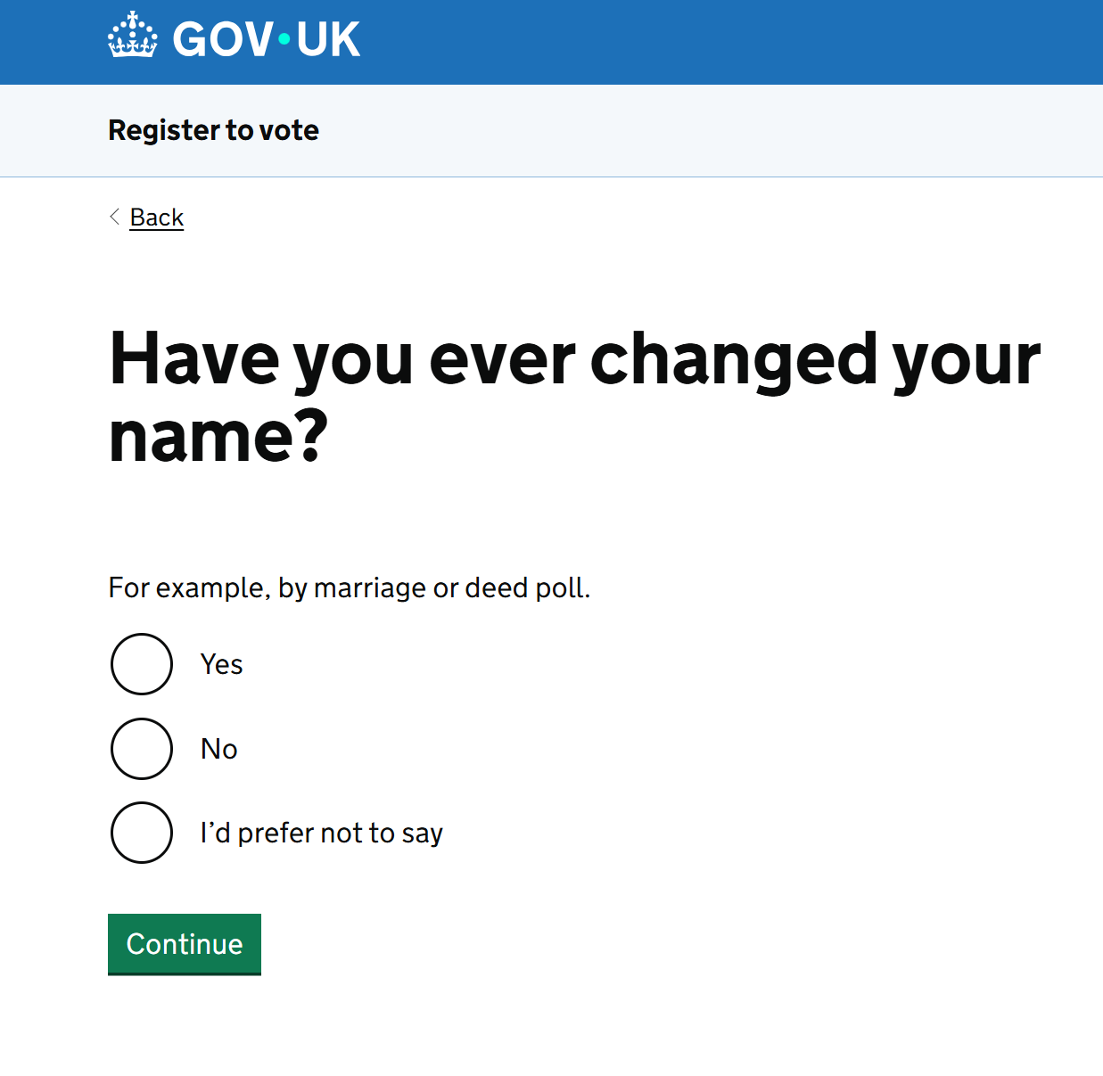
How do we register to vote? - Online
Making voting easier for everyone
Notes:
This is an opportunity to visit the site and look at how to register. If appropriate, then you could support young people to register to vote.
You could show them the website live here - Register to vote - GOV.UK. Note they can also use a search engine to look up 'register to vote' and this should be the top result.

Slide 14
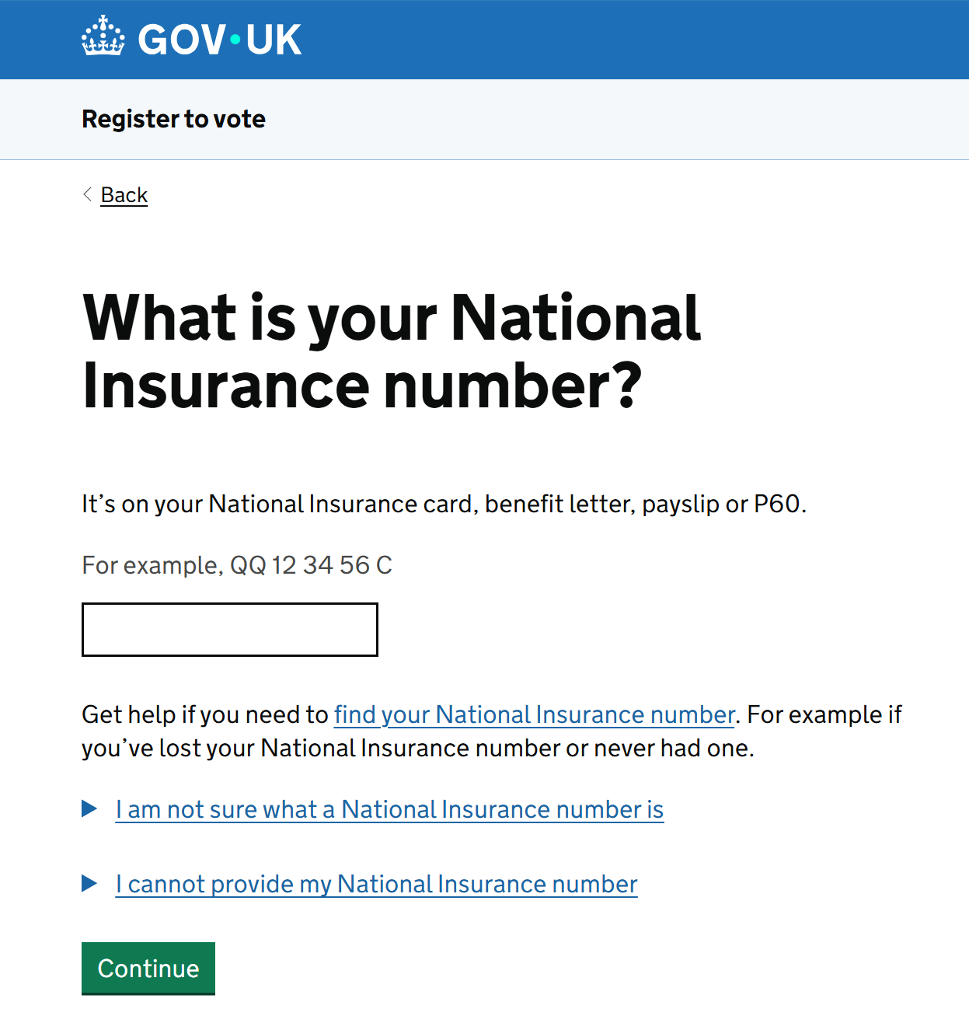
How do we register to vote? - Online
If you cannot find your National Insurance Number, you can still register to vote with alternative documents.
Making voting easier for everyone
Notes:
This is an opportunity to visit the site and look at how to register. If appropriate, then you could support young people to register to vote.
You could show them the website live here - Register to vote - GOV.UK. Note they can also use a search engine to look up 'register to vote' and this should be the top result.

Slide 15
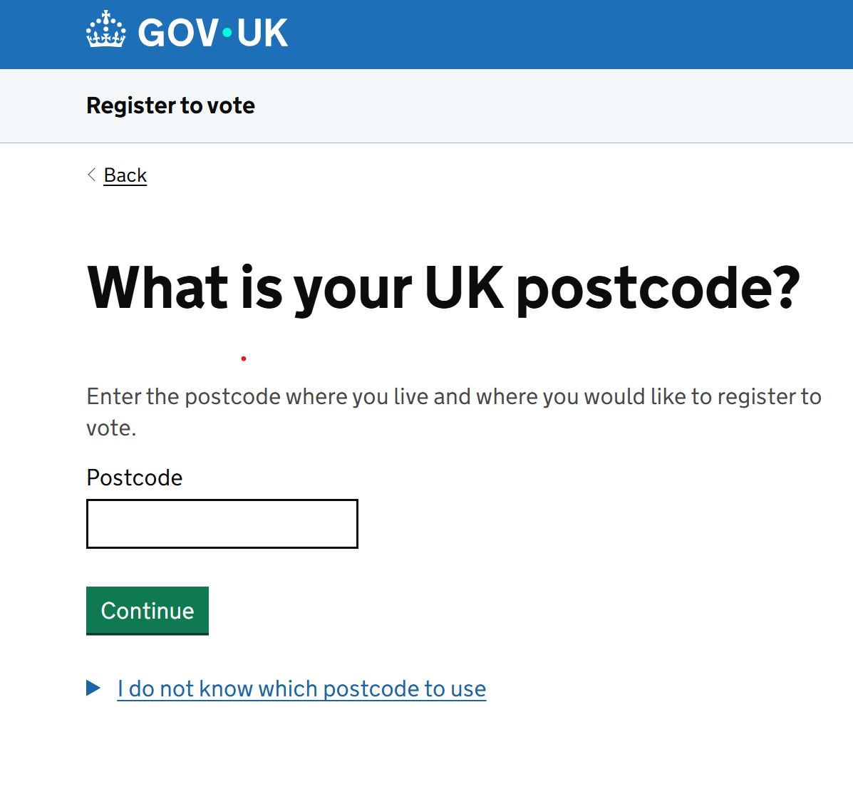
How do we register to vote? - Online
Where you vote will depend on your postcode so make sure this is accurate. You will then be asked to enter your full address.
Making voting easier for everyone
Notes:
This is an opportunity to visit the site and look at how to register. If appropriate, then you could support young people to register to vote.
You could show them the website live here - Register to vote - GOV.UK. Note they can also use a search engine to look up 'register to vote' and this should be the top result.

Slide 16
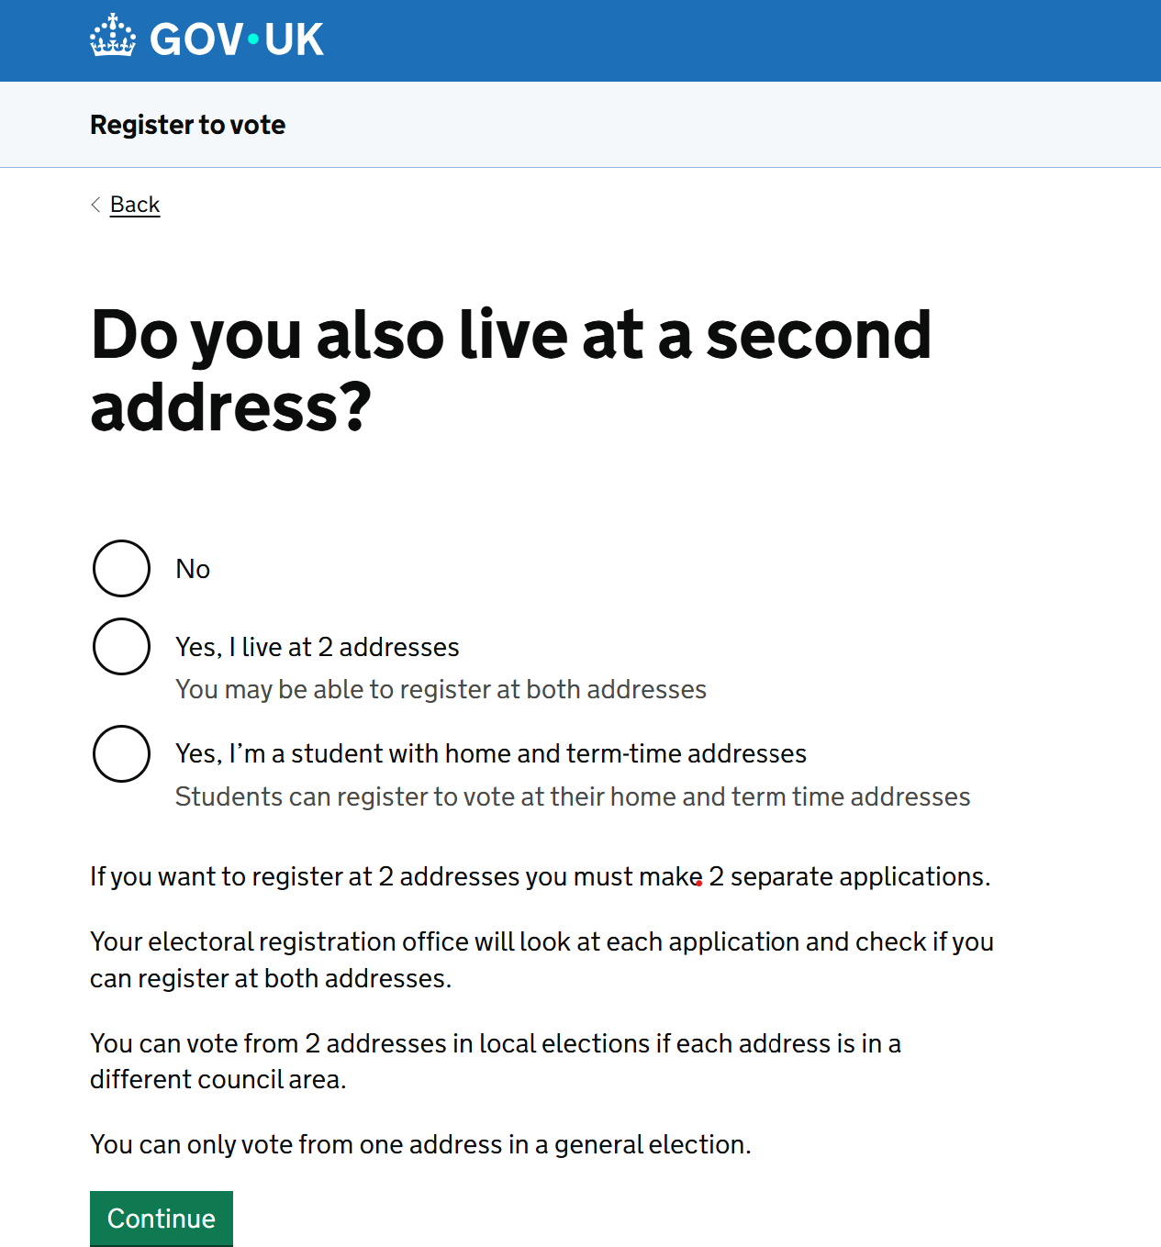
How do we register to vote? - Online
If you live in two different places, for example, if you split your time equally between parents' houses or live in student accommodation during term time, you can choose to register at one or both addresses.
Making voting easier for everyone
Notes:
This is an opportunity to visit the site and look at how to register. If appropriate, then you could support young people to register to vote.
You could show them the website live here - Register to vote - GOV.UK. Note they can also use a search engine to look up 'register to vote' and this should be the top result.

Slide 17
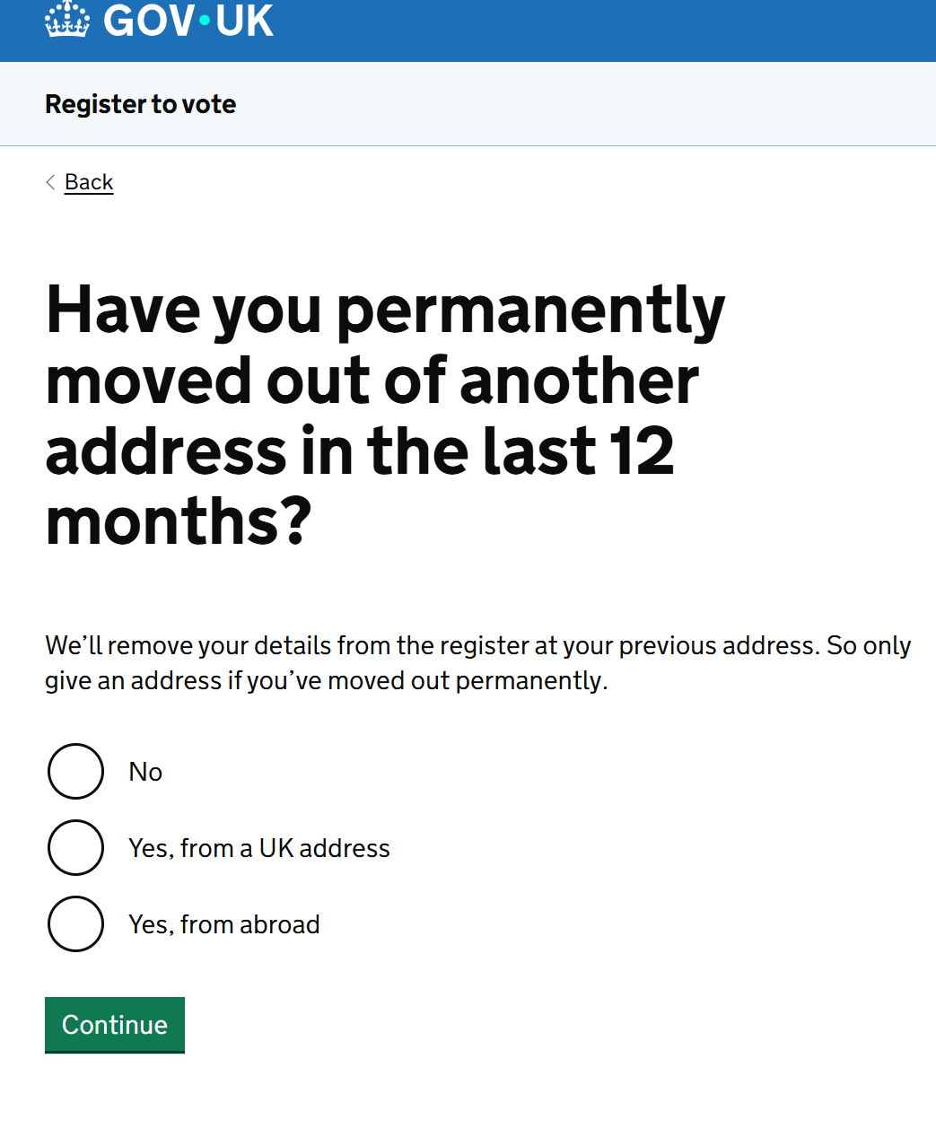
How do we register to vote? - Online
If you say you have moved out of another address in the last 12 months, you will need to put this address down too so make sure you have it handy.
Making voting easier for everyone
Notes:
This is an opportunity to visit the site and look at how to register. If appropriate, then you could support young people to register to vote.
You could show them the website live here - Register to vote - GOV.UK. Note they can also use a search engine to look up 'register to vote' and this should be the top result.

Slide 18
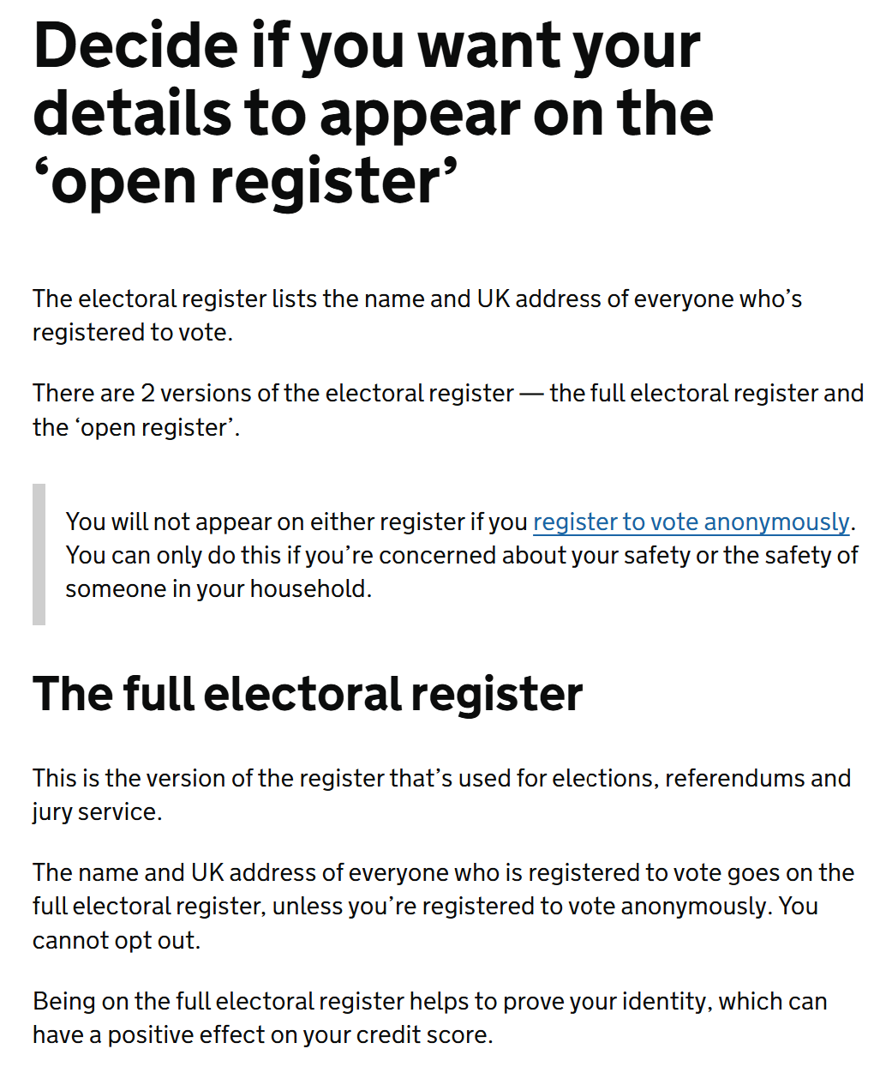
How do we register to vote? - Online
You will choose if you appear on the open register – anyone can buy the open register and it is used for different reasons such as opinion polls and marketing.
Making voting easier for everyone
Notes:
This is an opportunity to visit the site and look at how to register. If appropriate, then you could support young people to register to vote.
You could show them the website live here - Register to vote - GOV.UK. Note they can also use a search engine to look up 'register to vote' and this should be the top result.

Slide 19
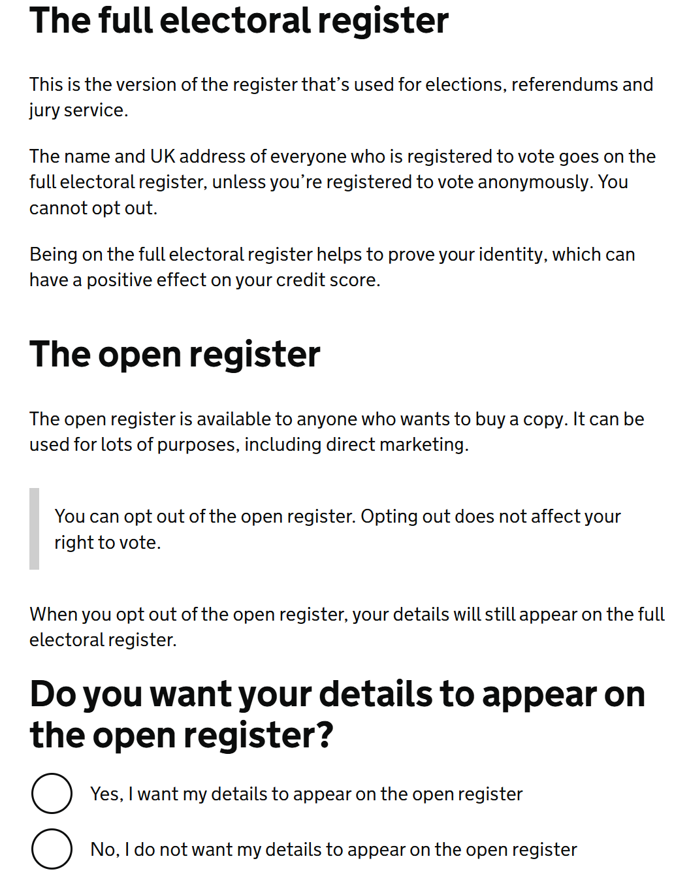
How do we register to vote? - Online
It is entirely your choice if you appear on the open register or not.
Making voting easier for everyone
Notes:
This is an opportunity to visit the site and look at how to register. If appropriate, then you could support young people to register to vote.
You could show them the website live here - Register to vote - GOV.UK. Note they can also use a search engine to look up 'register to vote' and this should be the top result.

Slide 20
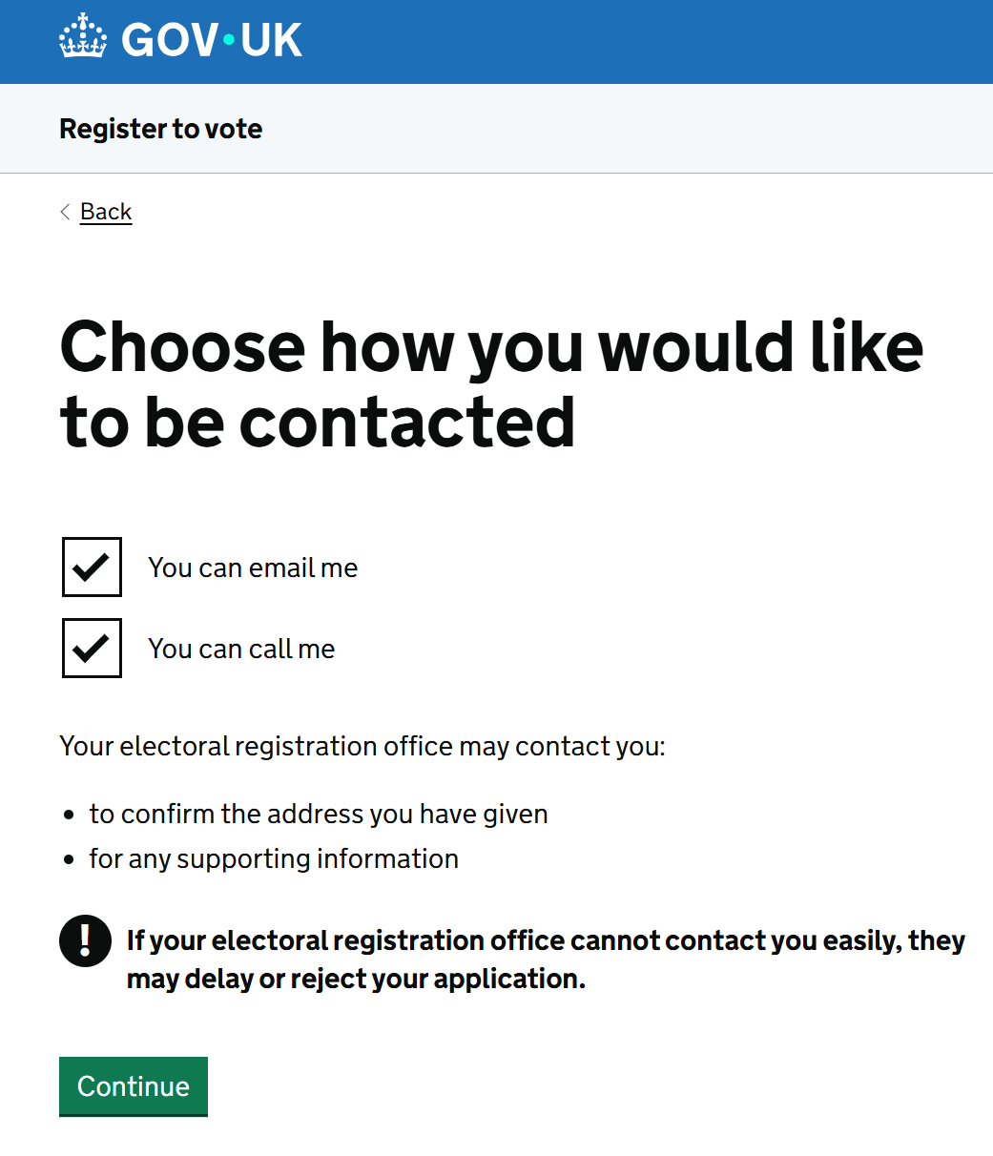
How do we register to vote? - Online
Sometimes, the electoral registration office may need to contact you. Choose if you would prefer to speak to someone over the phone or if you would prefer emails.
Making voting easier for everyone
Notes:
This is an opportunity to visit the site and look at how to register. If appropriate, then you could support young people to register to vote.
You could show them the website live here - Register to vote - GOV.UK. Note they can also use a search engine to look up 'register to vote' and this should be the top result.

Slide 21
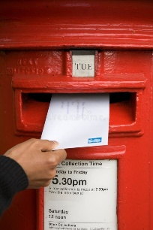
How do we register to vote? - Post
If you find using the online form hard, or prefer to complete a paper form, then you can!
Download the form from this page - www.gov.uk/government/publications/register-to-vote-if-youre-living-in-the-uk
Once you have completed the form, you will need to post it to your local Electoral Registration Office.
You can find your local office using this page - www.gov.uk/contact-electoral-registration-office
Making voting easier for everyone
Notes:
If appropriate, then you could support young people to register to vote using this method. You could also create tasks to find local electoral registration office.

Slide 22
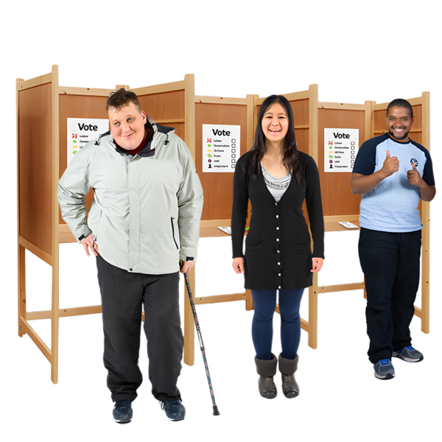
How do we register to vote? - Easy read
People who have a learning disability, autism or any other sort of additional need can vote.
If you want to vote in England and Northern Ireland you need to register to vote. You can register to vote when you are 16.
Making voting easier for everyone
Notes:
This is the main part of the topic. The commonwealth part will need expanding upon.

Slide 23

How do we register to vote? - Easy read
You can register to vote online
You can also register by printing off a form and posting it to your local Electoral Registration Office.
You can get help from your local Electoral Registration Office.
You need to have your National Insurance Number, and know your full postcode, date of birth and your full name when you register to vote.
Find your National Insurance number - GOV.UK
Making voting easier for everyone
Notes:
This is the main written task

Slide 24
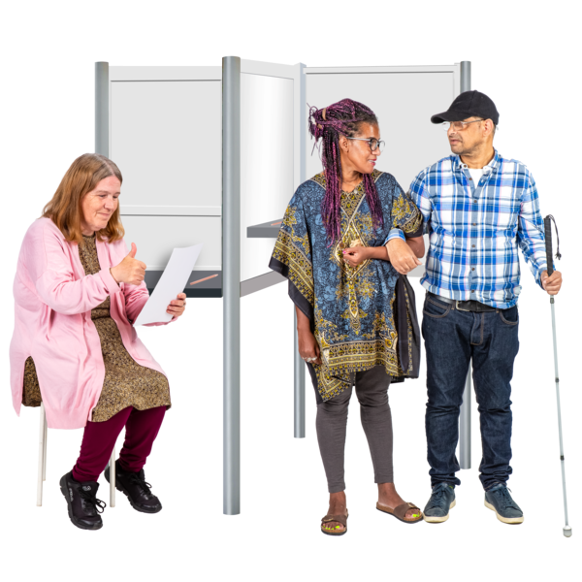
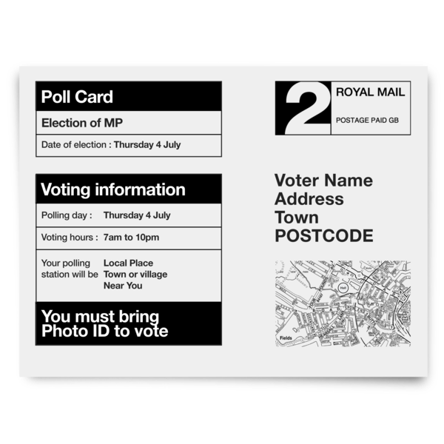
How do we register to vote? - Easy read
You might want to get help from someone to help you register to vote as the form can be a little bit complicated.
Once you have completed the form, you will get a message (either by email or through the post) saying you are now registered to vote!
Once you are registered to vote you will get a poll card through the post whenever there is something for you to vote about.
Making voting easier for everyone
Notes:
This is the main written task

Slide 25
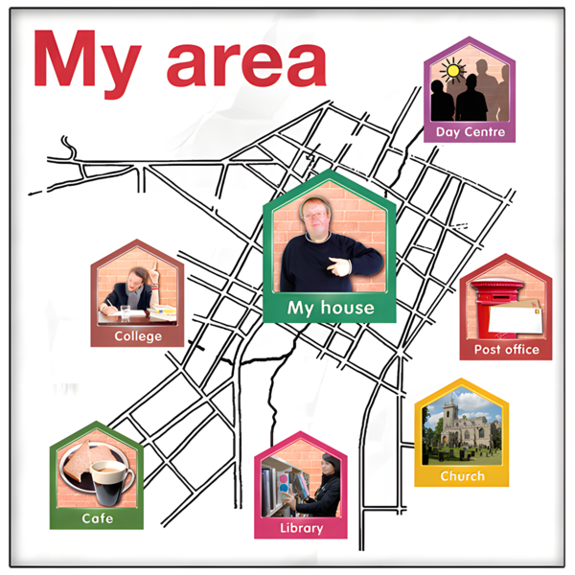

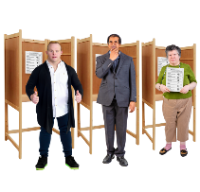
How do we register to vote? - Easy read
People in England and Northern Ireland vote for MPs and Local Councillors to speak for them and represent their views.
You can vote for MPs when there is a General Election. The Party which has the most MPs voted for becomes the Government.
You can vote for Local Councillors in Local Elections. The Local Councillors who get the most votes are put in charge of the Local Authorities.
Making voting easier for everyone
Notes:
This is the main written task

